Slide 1
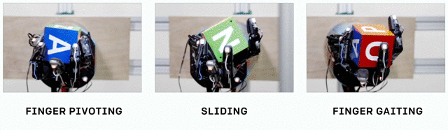
Learning for Manipulation
Grace Eysenbach, Nao Ouyang,
Maggie Wang, Michael Emanuel
Notes:
Grace
Criteria:
sufficient background/motivation
relevant related work
contribution of the work
answer questions effectively
clear and structured manner
well-organized and prepared

Slide 2

Outline
Background and Motivation
Learning Hand-Eye Coordination for Robot Grasping with DL and Large-Scale Data Collection (Google)
Learning Dexterous In-Hand Manipulation (OpenAI)
Contributions, Context, Limitations, Future Work
Questions
Background and Motivation
Notes:
Grace
Setup
What is the problem?
Why is it important?
What are the key challenges in solving it?
Contribution
What did the author(s) do?
Why was it novel?
Context
How did it compare to other work?
What work did this build on?
What are the relative strengths and weaknesses?

Slide 3
Motivation
Notes:
Grace

Slide 4
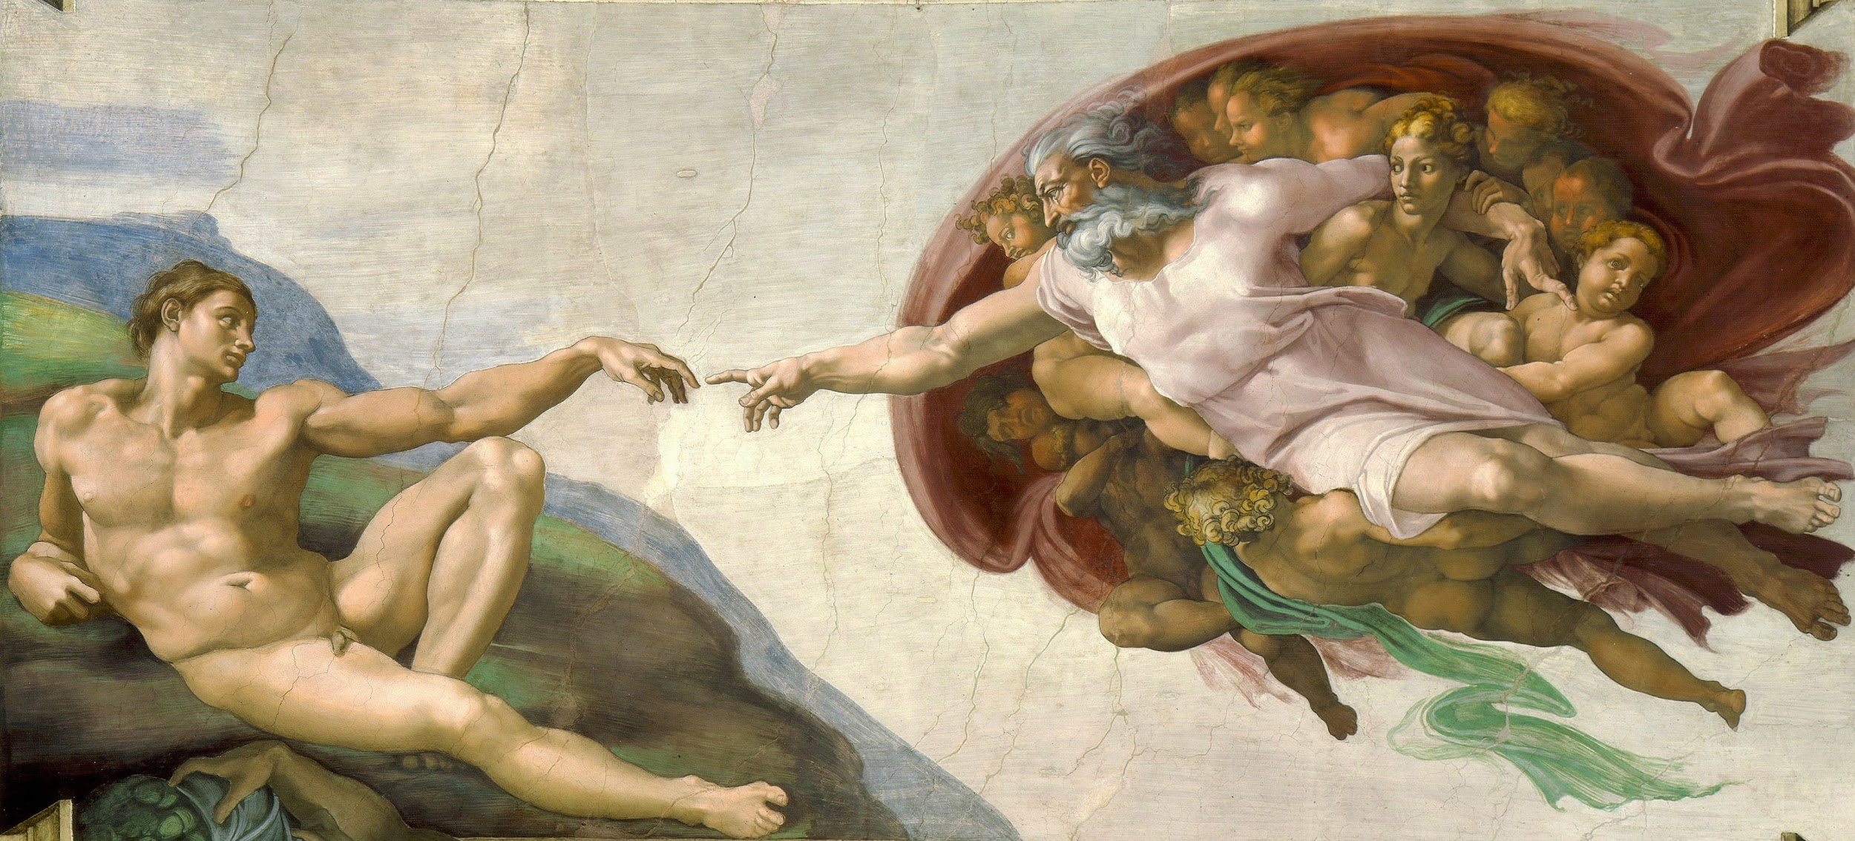
Humans’ Ability for Manipulation
The Creation of Adam
Michelangelo, the Sistine Chapel
Notes:
Manipulating our environment with our hands is a quintessentially human capacity
The human hand is unparalleled in the animal kingdom
Together with our brains, our hands are arguably the key behind our dominance over life on earth

Slide 5
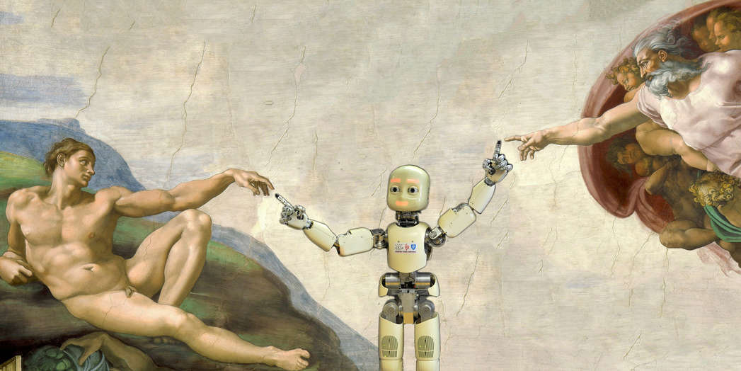
Robots’ Ability for Manipulation
The Creation of Adam
Michelangelo, the Sistine Chapel
Notes:
Human-level manipulative capacity is a dream of robotics
But real robots fall far short of human dexterity

Slide 6
The Robot Grasping Problem
Why is this so hard? Huge control space!
The problem is easy to state, hard to get right:
We are still very far from robots that can perform even routine household dexterous tasks, e.g. laundry folding
Background and Motivation
Notes:
(huge control space): Typical industrial robot arms have 7 degrees of freedom. A single robot hand has 24 degrees of freedom!
(problem easy to state) Build a robot that can grasp different kinds of objects, without dropping them, and move them to a desired position / orientation
The problem closest to commercial applications is warehouse automation
Amazon in particular is aggressively pursuing this, e.g. with their purchase of Kiva systems

Slide 7
The Robot Grasping Problem
Why is this so hard? Huge control space!
The problem is easy to state, hard to get right:
We are still very far from robots that can perform even routine household dexterous tasks, e.g. laundry folding
Background and Motivation
Notes:
(huge control space): Typical industrial robot arms have 7 degrees of freedom. A single robot hand has 24 degrees of freedom!
(problem easy to state) Build a robot that can grasp different kinds of objects, without dropping them, and move them to a desired position / orientation
The problem closest to commercial applications is warehouse automation
Amazon in particular is aggressively pursuing this, e.g. with their purchase of Kiva systems

Slide 8
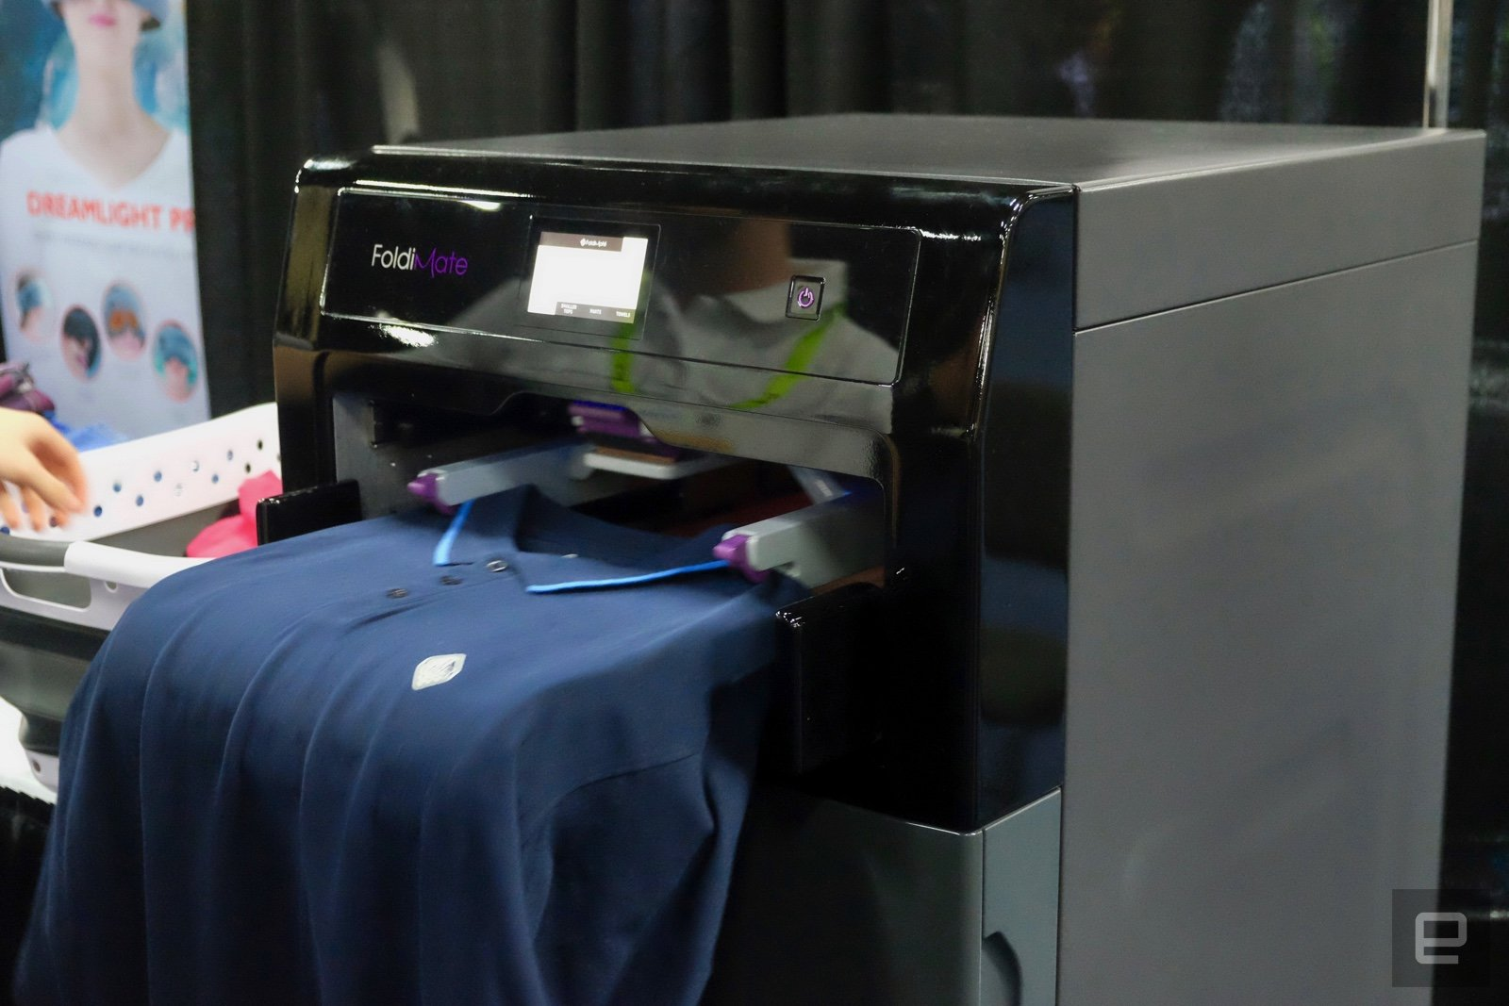
The Robot Grasping Problem
Why is this so hard? Huge control space!
The problem is easy to state, hard to get right:
We are still very far from robots that can perform even routine household dexterous tasks, e.g. laundry folding
Foldimate laundry folding machine: $1000, no hands, size of a microwave
Background and Motivation
Notes:
(huge control space): Typical industrial robot arms have 7 degrees of freedom. A single robot hand has 24 degrees of freedom!
(problem easy to state) Build a robot that can grasp different kinds of objects, without dropping them, and move them to a desired position / orientation
The problem closest to commercial applications is warehouse automation
Amazon in particular is aggressively pursuing this, e.g. with their purchase of Kiva systems

Slide 9
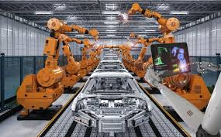
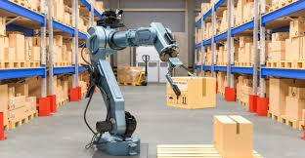
Robotic Manipulation in the Real World
Industrial robots have impressive achievements
But they are very specialized and work only in highly controlled environments
Humans can handle a far greater range of tasks
Applications:
Warehouse robots
Package delivery
Hospitals: assisting nursing staff with bed linens
Home: Roomba is the world’s top selling robot
Industrial robots for automotive assembly
Warehouse robots for moving boxes onto pallets
Background and Motivation
Notes:
Grace

Slide 10
Robotic Manipulation in the Real World
Industrial robots have impressive achievements
But they are very specialized and work only in highly controlled environments
Humans can handle a far greater range of tasks
Applications:
Warehouse robots
Package delivery
Hospitals: assisting nursing staff with bed linens
Home: Roomba is the world’s top selling robot
Industrial robots for automotive assembly
Warehouse robots for moving boxes onto pallets
Background and Motivation
Notes:
Grace

Slide 11
Robotic Manipulation in the Real World
Industrial robots have impressive achievements
But they are very specialized and work only in highly controlled environments
Humans can handle a far greater range of tasks
Applications:
Warehouse robots
Package delivery
Hospitals: assisting nursing staff with bed linens
Home: Roomba is the world’s top selling robot
Industrial robots for automotive assembly
Warehouse robots for moving boxes onto pallets
Background and Motivation
Notes:
Grace

Slide 12
Robotic Manipulation in the Real World
Industrial robots have impressive achievements
But they are very specialized and work only in highly controlled environments
Humans can handle a far greater range of tasks
Applications:
Warehouse robots
Package delivery
Hospitals: assisting nursing staff with bed linens
Home: Roomba is the world’s top selling robot
Industrial robots for automotive assembly
Warehouse robots for moving boxes onto pallets
Background and Motivation
Notes:
Grace

Slide 13
Making Robots Generalizable
A major goal is to build robots with flexible, generalizable grasping + manipulation skills
Challenging technical aspects of expanding out of controlled industrial environment
Huge control space
Huge variety of objects in the world
Huge variety of domains
Background and Motivation
Notes:
Grace

Slide 14
Making Robots Generalizable
A major goal is to build robots with flexible, generalizable grasping + manipulation skills
Challenging technical aspects of expanding out of controlled industrial environment
Huge control space
Huge variety of objects in the world
Huge variety of domains
Background and Motivation
Notes:
Grace

Slide 15
Background:
Grasping and Manipulation
Notes:
Grace

Slide 16
Grasping

Slide 17
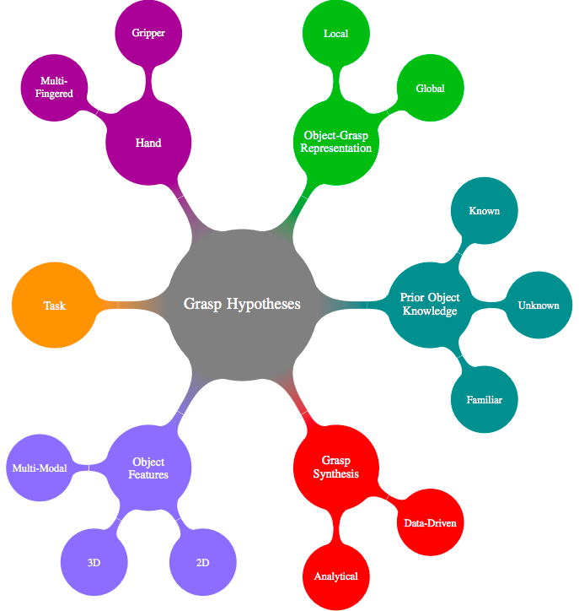
Visualizing the Robotics Grasping Challenge
Bohg et al., 2014
Related Works: Grasping

Slide 18
Grasp Synthesis: Analytical vs. Data-Driven
Analytical → Creating kinematic and dynamic models to apply to grasping
(+) Good for tasks that where object positions and environments are predictable
(-) Inaccurate models + noisy sensors leads to lots of positioning errors
Dominated the field until early 2000s
Related Works: Grasping
Notes:
The first thing we have to think about how the grasp is enabled

Slide 19
Grasp Synthesis: Analytical vs. Data-Driven
Analytical → Creating kinematic and dynamic models to apply to grasping
(+) Good for tasks that where object positions and environments are predictable
(-) Inaccurate models + noisy sensors leads to lots of positioning errors
Dominated the field until early 2000s
Related Works: Grasping

Slide 20
Grasp Synthesis: Analytical vs. Data-Driven
Analytical → Creating kinematic and dynamic models to apply to grasping
(+) Good for tasks that where object positions and environments are predictable
(-) Inaccurate models + noisy sensors leads to lots of positioning errors
Dominated the field until early 2000s
Related Works: Grasping

Slide 21
Grasp Synthesis: Analytical vs. Data-Driven
Analytical → Creating kinematic and dynamic models to apply to grasping
(+) Good for tasks that where object positions and environments are predictable
(-) Inaccurate models + noisy sensors leads to lots of positioning errors
Dominated the field until early 2000s
Related Works: Grasping

Slide 22
Grasp Synthesis: Analytical vs. Data-Driven
Data-Driven → relies on sampling grasp candidates for an object and ranking them according to a specific metric using existing grasp experience
(+) Much larger range of potential applications
(-) Challenges of data collection + representation
Related Works: Grasping

Slide 23
Grasp Synthesis: Analytical vs. Data-Driven
Data-Driven → relies on sampling grasp candidates for an object and ranking them according to a specific metric using existing grasp experience
(+) Much larger range of potential applications
(-) Challenges of data collection + representation
Related Works: Grasping

Slide 24
Grasp Synthesis: Analytical vs. Data-Driven
Data-Driven → relies on sampling grasp candidates for an object and ranking them according to a specific metric using existing grasp experience
(+) Much larger range of potential applications
(-) Challenges of data collection + representation
Related Works: Grasping

Slide 25
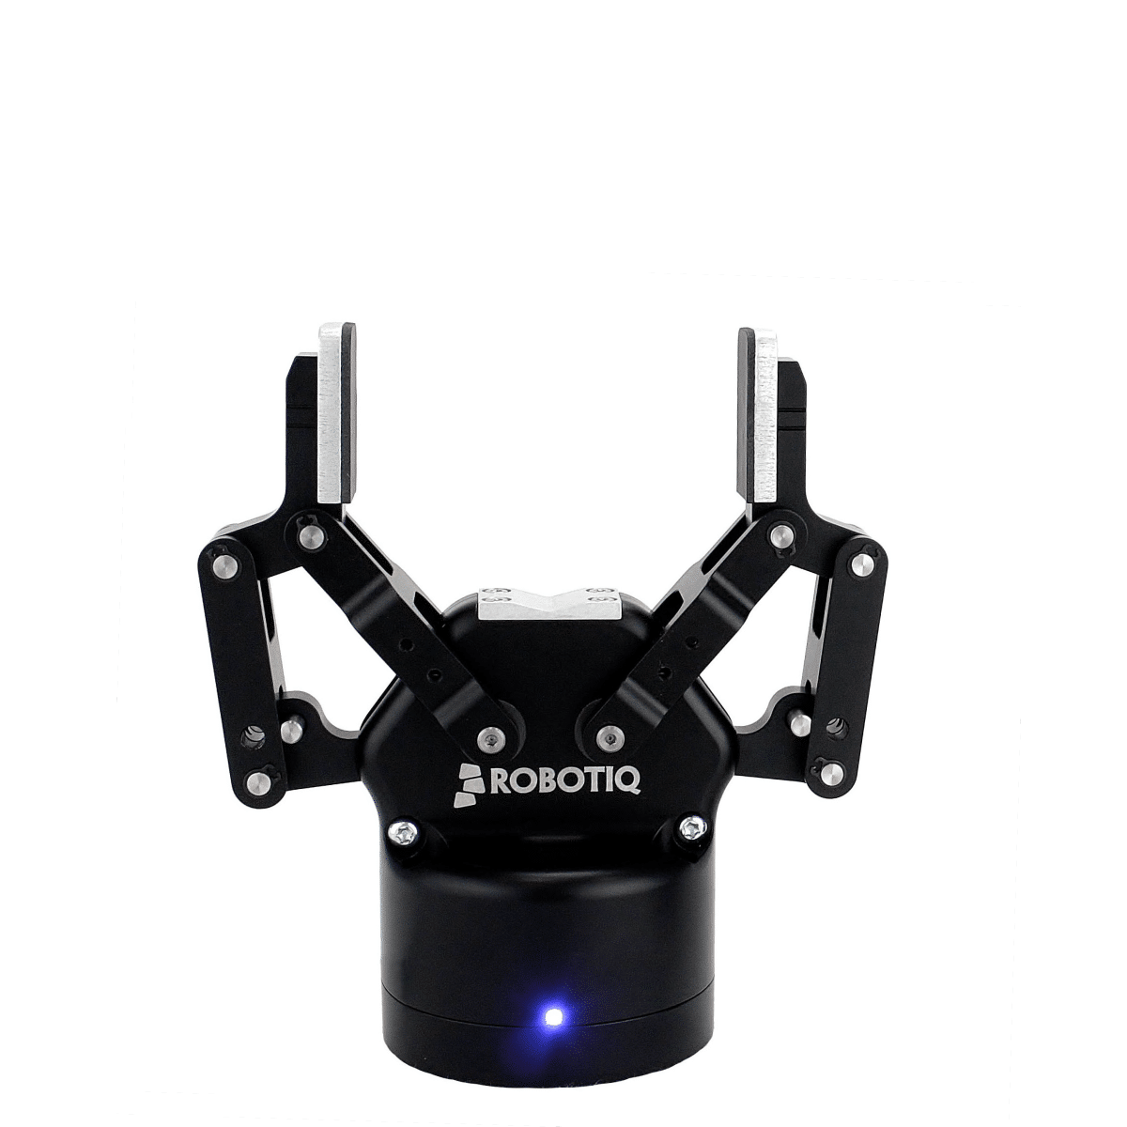
Means of Grasping: Gripper vs. Multi-Fingered
Gripper → “Learning Hand-Eye Coordination for Robotic Grasping”
Related Works: Grasping

Slide 26
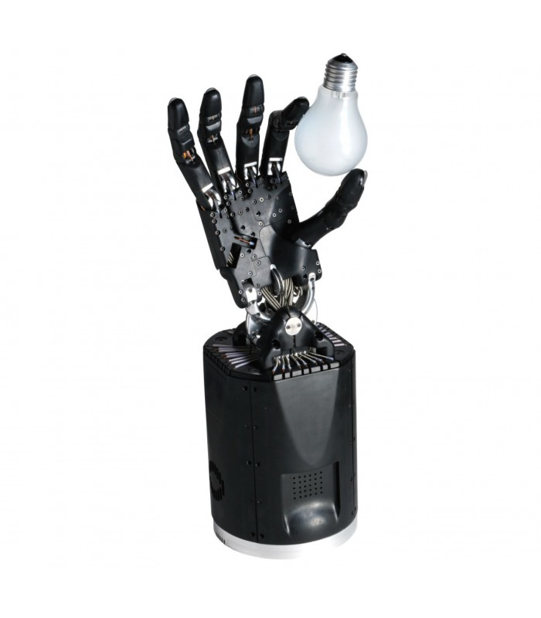
Means of Grasping: Gripper vs. Multi-Fingered
Gripper → “Learning Hand-Eye Coordination for Robotic Grasping”
Multi-Fingered → “Learning Dexterous In-Hand Manipulation”
Related Works: Grasping

Slide 27
Means of Grasping: Gripper vs. Multi-Fingered
Gripper → “Learning Hand-Eye Coordination for Robotic Grasping”
Multi-Fingered → “Learning Dexterous In-Hand Manipulation”
Main Idea:
Higher DoF = Higher Complexity = Higher Possibilities
Related Works: Grasping

Slide 28
Prior Object Knowledge: Known vs. Familiar vs. Unknown
Known → once an object is recognized, estimate its pose, and retrieve suitable grasp from existing experience database
(+) Good for specific tasks where you would expect to only see a set of objects
(-) Does not allow learning from new objects + environments
Related Works: Grasping

Slide 29
Prior Object Knowledge: Known vs. Familiar vs. Unknown
Known → once an object is recognized, estimate its pose, and retrieve suitable grasp from existing experience database
(+) Good for specific tasks where you would expect to only see a set of objects
(-) Does not allow learning from new objects + environments
Related Works: Grasping

Slide 30
Prior Object Knowledge: Known vs. Familiar vs. Unknown
Known → once an object is recognized, estimate its pose, and retrieve suitable grasp from existing experience database
(+) Good for specific tasks where you would expect to only see a set of objects
(-) Does not allow learning from new objects + environments
Related Works: Grasping

Slide 31
Prior Object Knowledge: Known vs. Familiar vs. Unknown
Familiar → Plan grasp of object by identifying common characteristics with objects in the database
Low Level: texture, shape
High Level: functionality (pouring, rolling)
Develop a “similarity metric” to compare object + make grasps transferable
Related Works: Grasping

Slide 32
Prior Object Knowledge: Known vs. Familiar vs. Unknown
Familiar → Plan grasp of object by identifying common characteristics with objects in the database
Low Level: texture, shape
High Level: functionality (pouring, rolling)
Develop a “similarity metric” to compare object + make grasps transferable
Related Works: Grasping

Slide 33
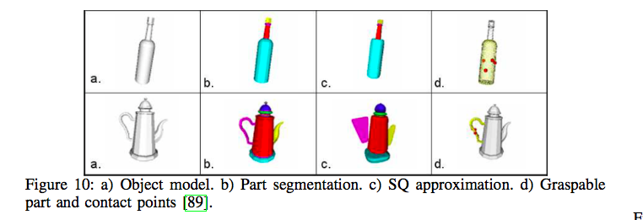
Similar Object Approaches
Using ANN to distinguish between graspable and non-graspable parts of object
(El-Koury and Sahbani, 2008)
Related Works: Grasping
Notes:
Grace

Slide 34
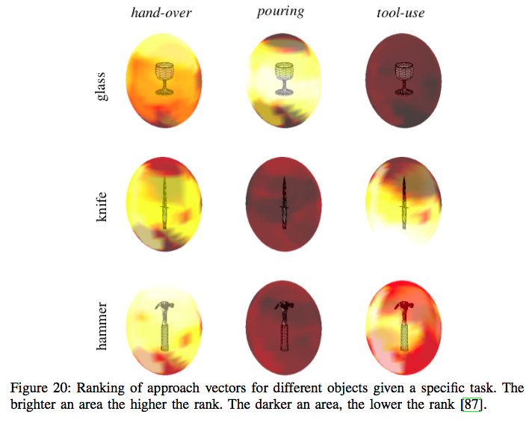
Similar Object Approaches
Using ANN to distinguish between graspable and non-graspable parts of object
(El-Koury and Sahbani, 2008)
Generating model for grasping using Bayesian learning
(Song et al., 2011)
Related Works: Grasping
Notes:
Grace

Slide 35
Prior Object Knowledge: Known vs. Familiar vs. Unknown
Unknown → Assume no access to model of OR grasp experience with the object.
Method: Combine sensory data with heuristics to analyze candidate grasps
(+) Allows most applicability to real world scenarios
(-) Many challenges in trying to estimate object / grasps using sparse, noisy, or incomplete sensor data
Related Works: Grasping

Slide 36
Prior Object Knowledge: Known vs. Familiar vs. Unknown
Unknown → Assume no access to model of OR grasp experience with the object.
Method: Combine sensory data with heuristics to analyze candidate grasps
(+) Allows most applicability to real world scenarios
(-) Many challenges in trying to estimate object / grasps using sparse, noisy, or incomplete sensor data
Related Works: Grasping

Slide 37
Prior Object Knowledge: Known vs. Familiar vs. Unknown
Unknown → Assume no access to model of OR grasp experience with the object.
Method: Combine sensory data with heuristics to analyze candidate grasps
(+) Allows most applicability to real world scenarios
(-) Many challenges in trying to estimate object / grasps using sparse, noisy, or incomplete sensor data
Related Works: Grasping

Slide 38
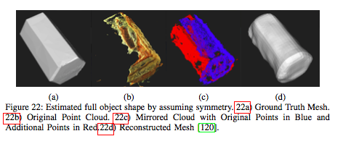
Unknown Object Approaches
Approximating unknown object shape using symmetry
(Bohg et al., 2011)
Related Works: Grasping
Notes:
Grace

Slide 39
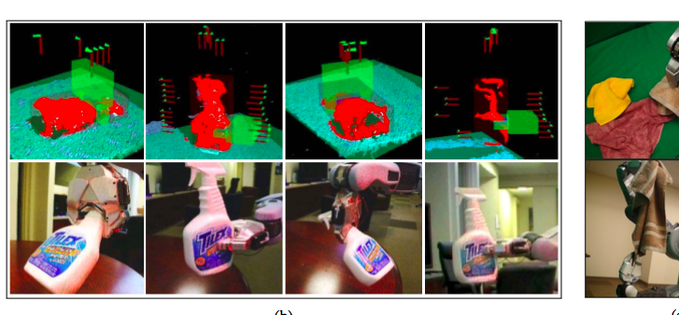
Unknown Object Approaches
Approximating unknown object shape using symmetry
(Bohg et al., 2011)
Generating grasp hypotheses from segmented point cloud + ranking by considering specific features of the grasp
(Hsiao et al., 2010)
Related Works: Grasping
Notes:
Grace

Slide 40
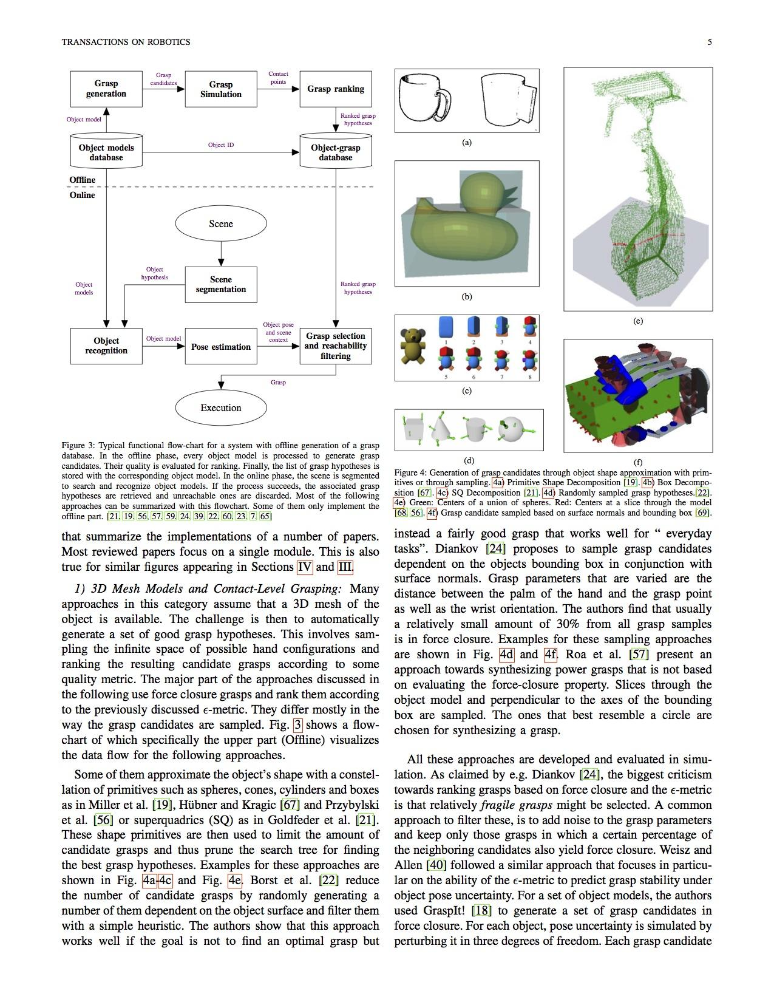
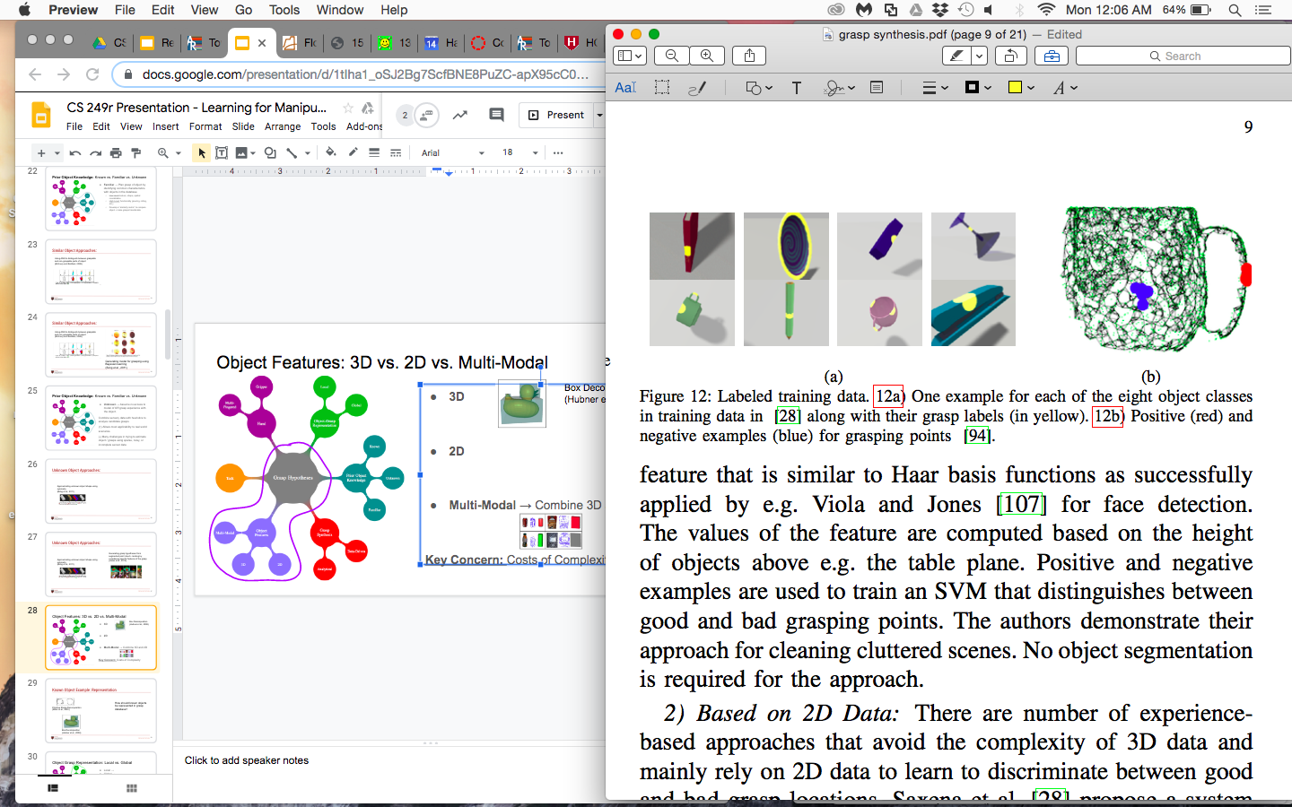
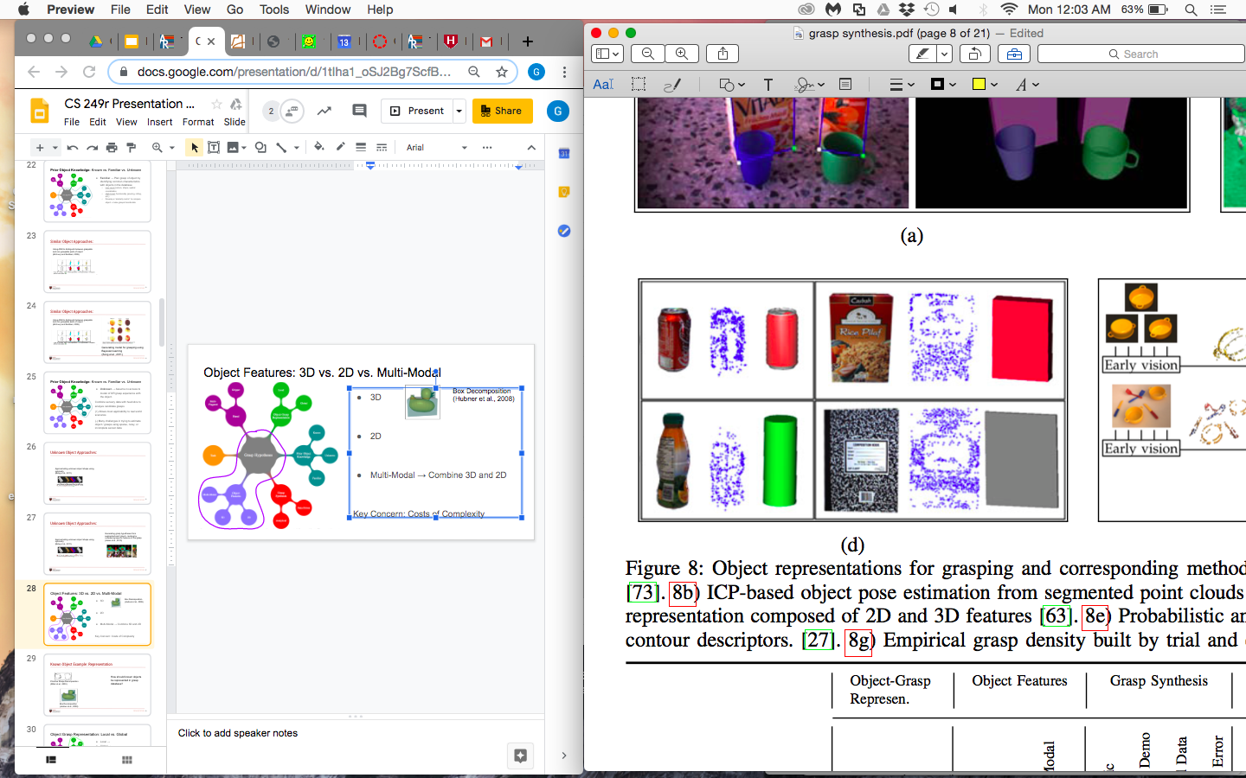
Object Features: 3D vs. 2D vs. Multi-Modal
Box Decomposition
(Hubner et al., 2008)
3D
2D
Multi-Modal → Combine 3D and 2D
Grasping Using Vision
(Saxena et al., 2008)
Multiview Object Representation
(Detry et al, 2009)
Related Works: Grasping

Slide 41
Object Features: 3D vs. 2D vs. Multi-Modal
Box Decomposition
(Hubner et al., 2008)
3D
2D
Multi-Modal → Combine 3D and 2D
Key Concern: Costs of Complexity
Grasping Using Vision
(Saxena et al., 2008)
Multiview Object Representation
(Detry et al, 2009)
Related Works: Grasping

Slide 42
Object Grasp Representation: Local vs. Global
Local → examining low level features (ex. Contour descriptors)
Global → examining shape of object as a whole (ex. Object outline)
Related Works: Grasping

Slide 43
Object Grasp Representation: Local vs. Global
Local → examining low level features (ex. Contour descriptors)
Global → examining shape of object as a whole (ex. Object outline)
Related Works: Grasping

Slide 44
Task: What do we want to do?
Main Idea: Understanding our task is central to making choices about all these other categories related to grasping!
Grasp database storage constraints?
Objects it will encounter?
Sensors on object?
Etc.
Related Works: Grasping

Slide 45
Task: What do we want to do?
Main Idea: Understanding our task is central to making choices about all these other categories related to grasping!
Grasp database storage constraints?
Objects it will encounter?
Sensors on object?
Etc.
Related Works: Grasping

Slide 46
Manipulation

Slide 47
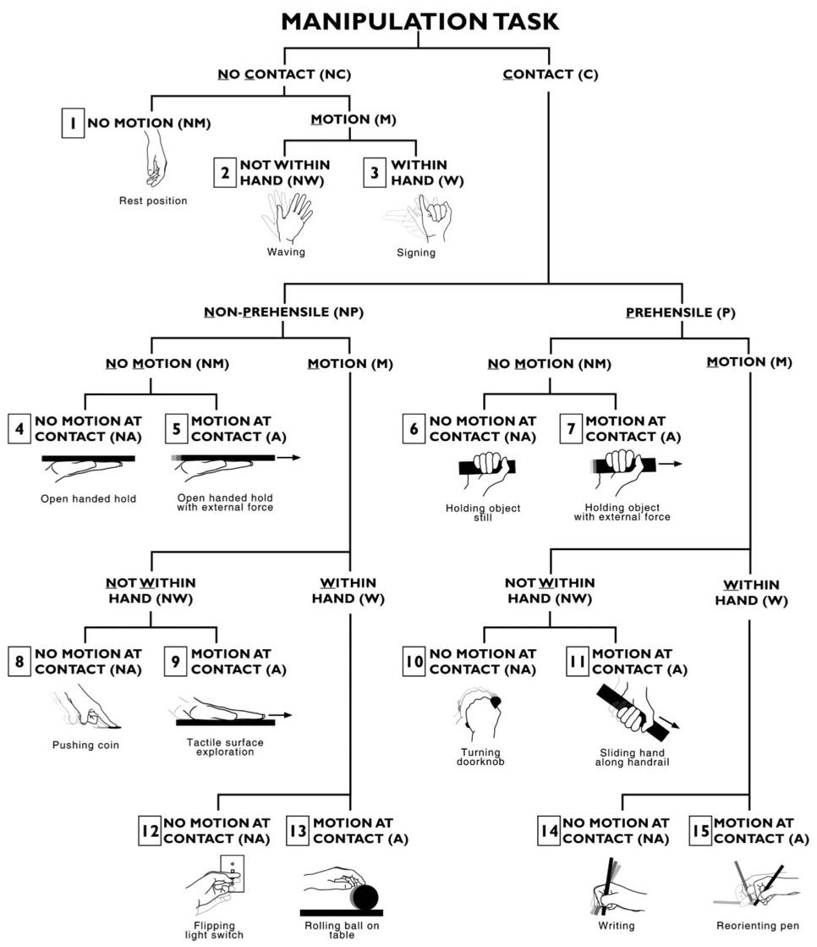
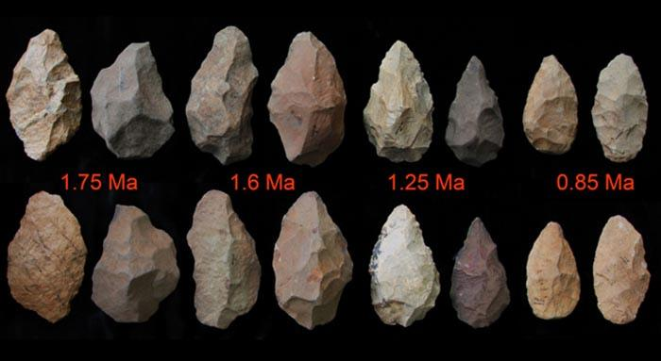
Defining Manipulation
Manipulation: Refers to an agent’s control of its environment through selective contact (Mason, 2018)
Fun Fact: Human’s fabrication of hand tools is seen a key influence in our development of fine manipulation skills (Mason, 2018)
Bullock et al. 2013
Related Works: Manipulation

Slide 48
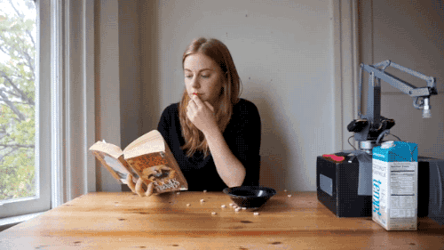
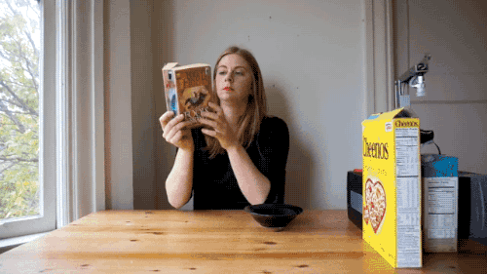
Types of Manipulation
Pick-and-Place Manipulation
In-Hand Manipulation
Manipulation is Hard!
Related Works: Manipulation

Slide 49
Pick-and-Place Manipulation
Bullock et al. 2013
Definition: Tasks that involve moving a sequence of objects one at a time from one place to another (Mason, 2018)
Related Works: Manipulation

Slide 50
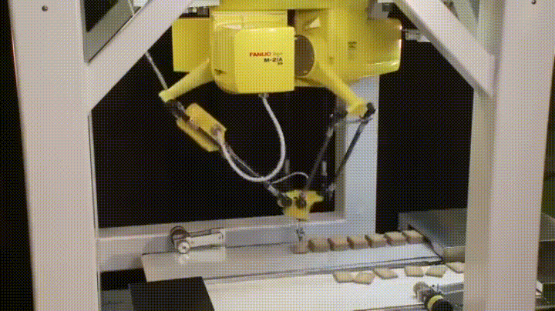
Pick-and-Place Manipulation
Definition: Tasks that involve moving a sequence of objects one at a time from one place to another (Mason, 2018)
Structured Pick-and-Place
Structured Environment = Engineered to simplify a task -- arranging objects in a predictable position + eliminating clutter
Related Works: Manipulation
Bullock et al. 2013

Slide 51
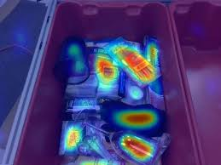
Pick-and-Place Manipulation
Definition: Tasks that involve moving a sequence of objects one at a time from one place to another (Mason, 2018)
Structured Pick-and-Place
Structured Environment = Engineered to simplify a task -- arranging objects in a predictable position + eliminating clutter
2. Unstructured Pick-and-Place
Path Planning
General-Purpose Grippers
Grasp + Placement Pose Planning
Related Works: Manipulation
Bullock et al. 2013

Slide 52
In-Hand Manipulation
Dexterous In-Hand Manipulation: the skillful turning and shifting objects in the hand through the motion of the palm and fingers
Bullock et al. 2013
Related Works: Manipulation

Slide 53
Grasping + Manipulation:
Relating to the Two Papers

Slide 54
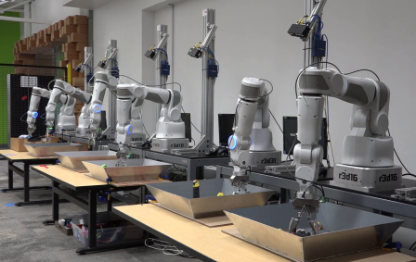
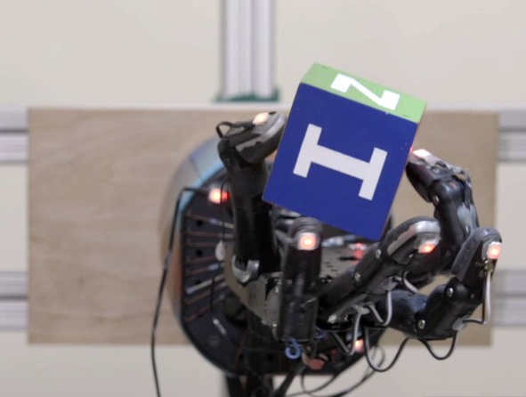
Overview of Two Papers Presented
Learning Hand-Eye Coordination for Robotic Grasping
Published by Google in 2016
They trained a robot arm with a 2 fingered gripper to pick up objects using only images from a single camera
Learning Dexterous In-Hand Manipulation
Published by OpenAI in 2018
Trained a Shadow Dexterous Hand robot to manipulate a block to a desired configuration
Learning Hand-Eye Coordination for Robotic Grasping: Experimental setup
Learning Dexterous In-Hand Manipulation: Shadow Hand holding cubic block
Background and Motivation
Notes:
Grace

Slide 55
Two Key Differences:
Defining Manipulation
Training Method
Related Works: Manipulation

Slide 56
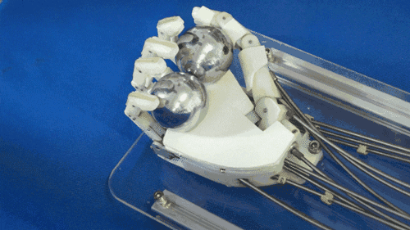
Defining Manipulation: Key Challenge
The Regrasp
Pick and Place → because the object is held rigidly, in order to regrasp, the object has to be put down and picked up with a new grasp
In-Hand → Uses increased degrees of freedom to move object while maintaining fixed or rolling contact
Related Works: Manipulation

Slide 57
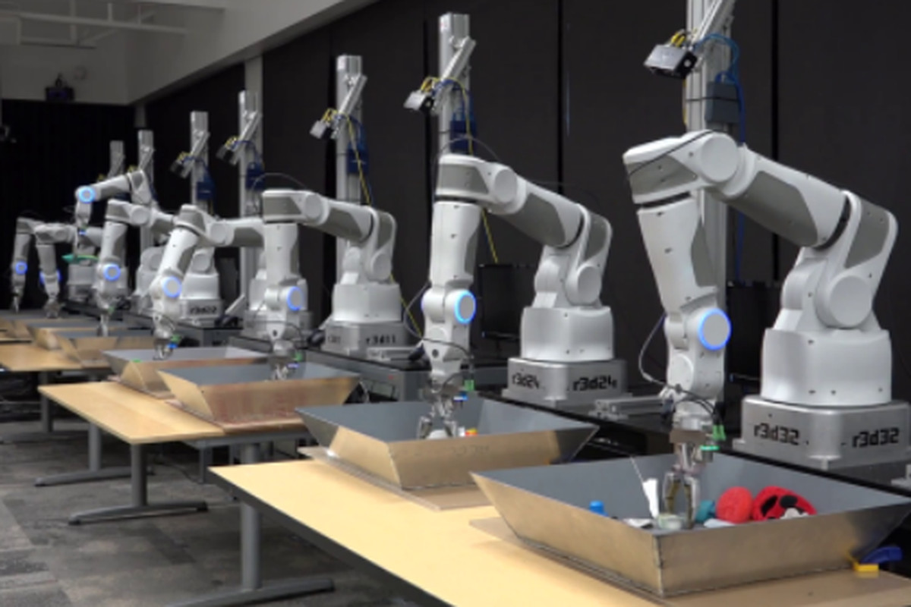
Defining Manipulation: Key Difference
The Google Paper → “Manipulation” = a single grasp/release per object
Unstructured Pick-And-Place
Related Works: Manipulation

Slide 58
Defining Manipulation: Key Difference
The Google Paper → “Manipulation” = a single grasp/release per object
Unstructured Pick-And-Place
The Open AI Paper → “Manipulation” = changing grasps to rotate object
In-Hand Manipulation
Related Works: Manipulation

Slide 59
2. Training Method: Key Challenge
The Sim-to-Real Transfer is a key consideration in deciding how robot will be trained
Training on Simulation → “Reality gap”, BUT allows massive amounts of training in limited time
Training on Robot → No “Reality gap”, BUT requires lots of time and expensive robotics hardware
Related Works: Manipulation

Slide 60
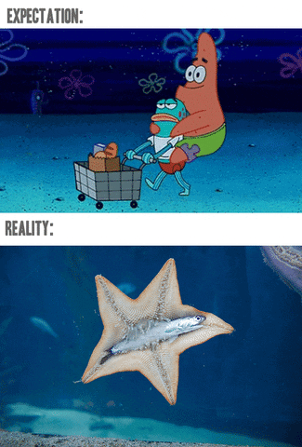
2. Training Method: Key Challenge
The Sim-to-Real Transfer is a key consideration in deciding how robot will be trained
Training on Simulation → “Reality gap”, BUT allows massive amounts of training in limited time
Training on Robot → No “Reality gap”, BUT requires lots of time and expensive robotics hardware
Related Works: Manipulation

Slide 61
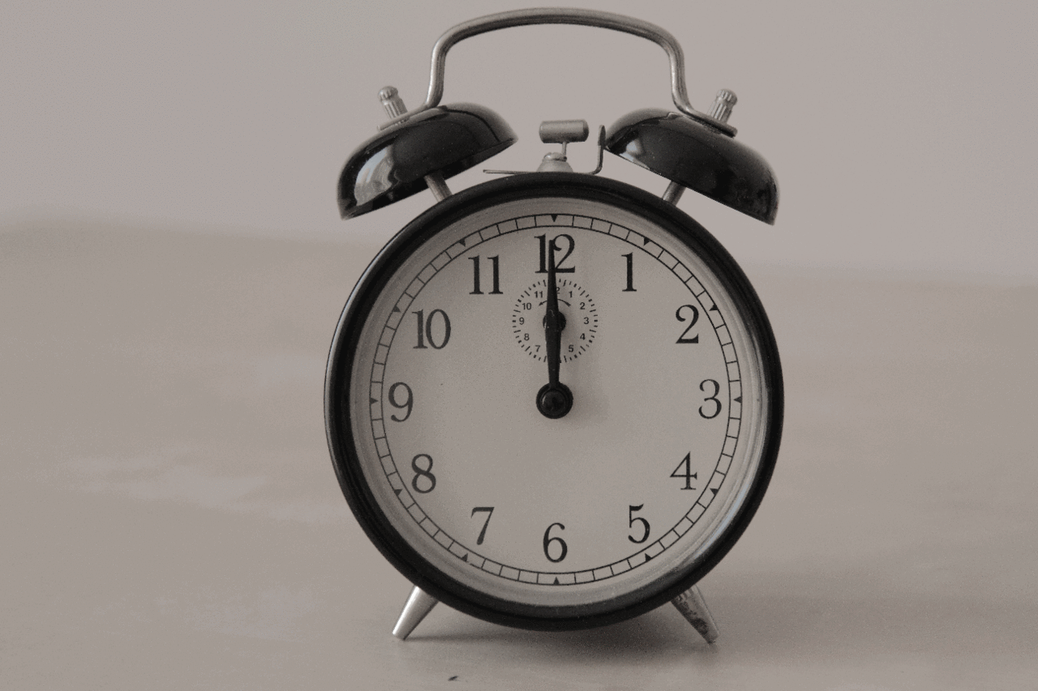
2. Training Method: Key Challenge
The Sim-to-Real Transfer is a key consideration in deciding how robot will be trained
Training on Simulation → “Reality gap”, BUT allows massive amounts of training in limited time
Training on Robot → No “Reality gap”, BUT requires lots of time and expensive robotics hardware
Related Works: Manipulation

Slide 62
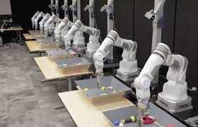
2. Training Method: Key Difference
The Google Paper → Trained exclusively on data from 800,000 grasping attempts in the real world
The OpenAI Paper → Trained on millions of simulator runs, then deployed on robot
Related Works: Manipulation

Slide 63
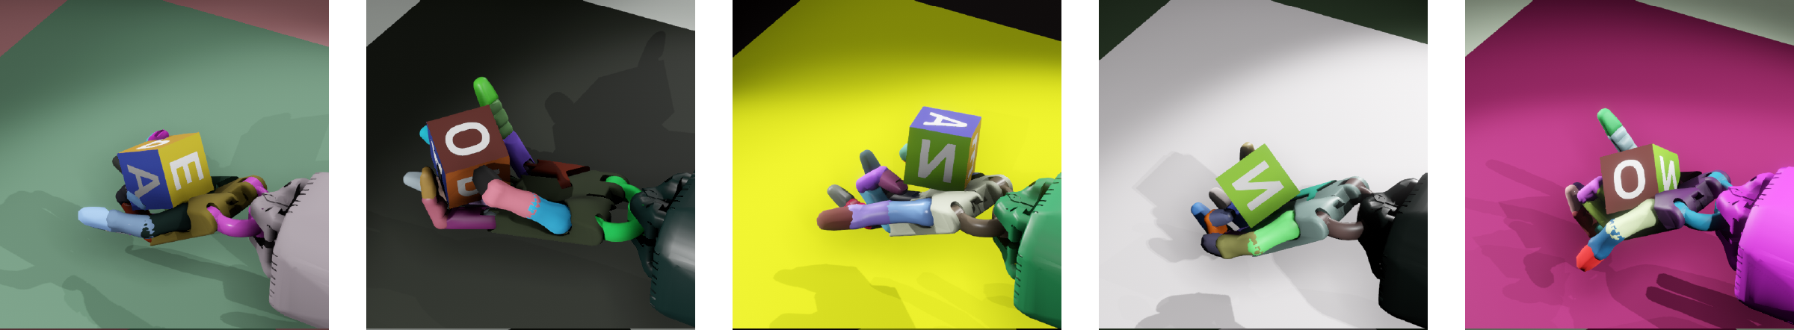
2. Training Method: Key Difference
The Google Paper → Trained exclusively on data from 800,000 grasping attempts in the real world
The OpenAI Paper → Trained on millions of simulator runs, then deployed on robot
Related Works: Manipulation

Slide 64
Common Thematic Elements
Reinforcement Learning
Google used RL in the real world; OpenAI used it in the simulator
OpenAI used Generalized Advantage Estimator (GAE) and Proximal Policy Optimization (PPO)
Google trained their NN as a supervised learning problem (predict grasping success)
Generalizability
OpenAI used domain randomization to improve generalizability
Google used a diverse range of object sizes, shapes and textures
sim2real (or other transfer learning), sim2sim
Sim2real gap was significant in OpenAI, but not so big the robot couldn’t perform well
Sim2sim arose when OpenAI trained robot to use vision only without ground truth position data
Background and Motivation
Notes:
transfer learning robustness - thematic element
google does it in a narrower context
openai does it in a broader context

Slide 65
Learning Hand-Eye Coordination for Robotic Grasping
with Deep Learning and Large-Scale Data Collection
Levine et al. (Google 2016)
Notes:
Maggie
https://www.youtube.com/watch?v=cXaic_k80uM&feature=youtu.be
https://spectrum.ieee.org/automaton/robotics/artificial-intelligence/google-large-scale-robotic-grasping-project

Slide 66
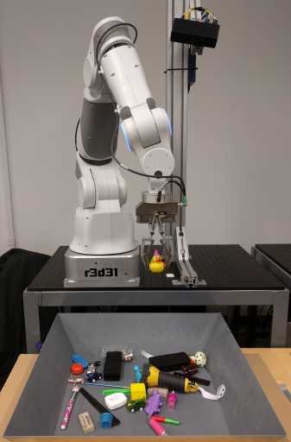
Main Contributions
Physical system: 7 DOF robot arm, 2 finger gripper, and an uncalibrated monocular camera
Novel CNN architecture that predicts grasping success
Continuous visual servoing function controls the robot
Large-scale data collection framework for robotic grasps
Learning Hand-Eye Coordination
Notes:
Maggie - 2 min
Hardware setup
7 degree-of-freedom robot arm with a two-fingered end-effector and an uncalibrated monocular camera
Independent of camera calibration or the current robot pose
Monocular - single image, as opposed to stereo vision
6-14 robots running continuously for two months
I will go over the three main contributions of this paper, which are as follows:
Novel CNN architecture for learning to predict the outcome of a grasp attempt
This highlights the data-driven method Grace talked about, as opposed to geometric methods.
Method for learning continuous visual servoing for robotic grasping from monocular images
Before this paper, visual servoing had been done, but typically required the features to be specified by hand
Large-scale data collection framework for robotic grasps.
800,000 grasp attempts

Slide 67
Main Contributions
Physical system: 7 DOF robot arm, 2 finger gripper, and an uncalibrated monocular camera
Novel CNN architecture that predicts grasping success
Continuous visual servoing function controls the robot
Large-scale data collection framework for robotic grasps
Learning Hand-Eye Coordination
Notes:
Maggie

Slide 68
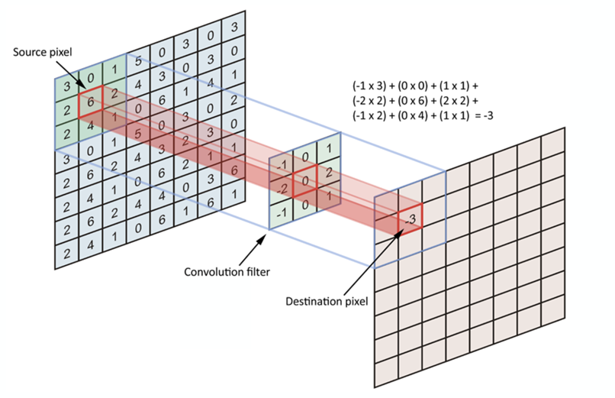
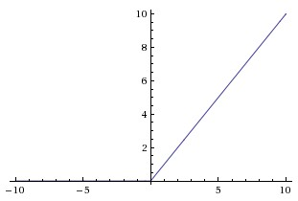
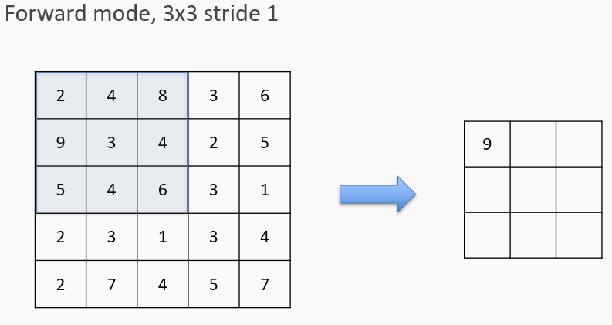
Convolutional Neural Network (CNN) Refresher
Convolutional Layers
Define features in terms of a local filter
Have a size and stride length
Max Pooling Layers
Summarize activity of a feature in an area
ReLU activation
Activation function a(x) = max(x, 0)
Images Credit: CS 109b Lecture Notes, Spring 2019
Learning Hand-Eye Coordination
Notes:
Maggie - 1 min
Before I talk about how the Google team used a CNN to predict grasping success, let me first give a refresher on the building blocks of CNNs.
A CNN is composed of convolutional layers, which define features in terms of a local filter. This filter is a matrix with some size, and gets moved around the image with some stride length.
The max pooling layer takes a matrix of some size and “summarizes” the area by taking the maximum value of the matrix.
An ReLU activation function essentially takes all of the negative values and turns them to 0, while keeping the positive values the same.

Slide 69
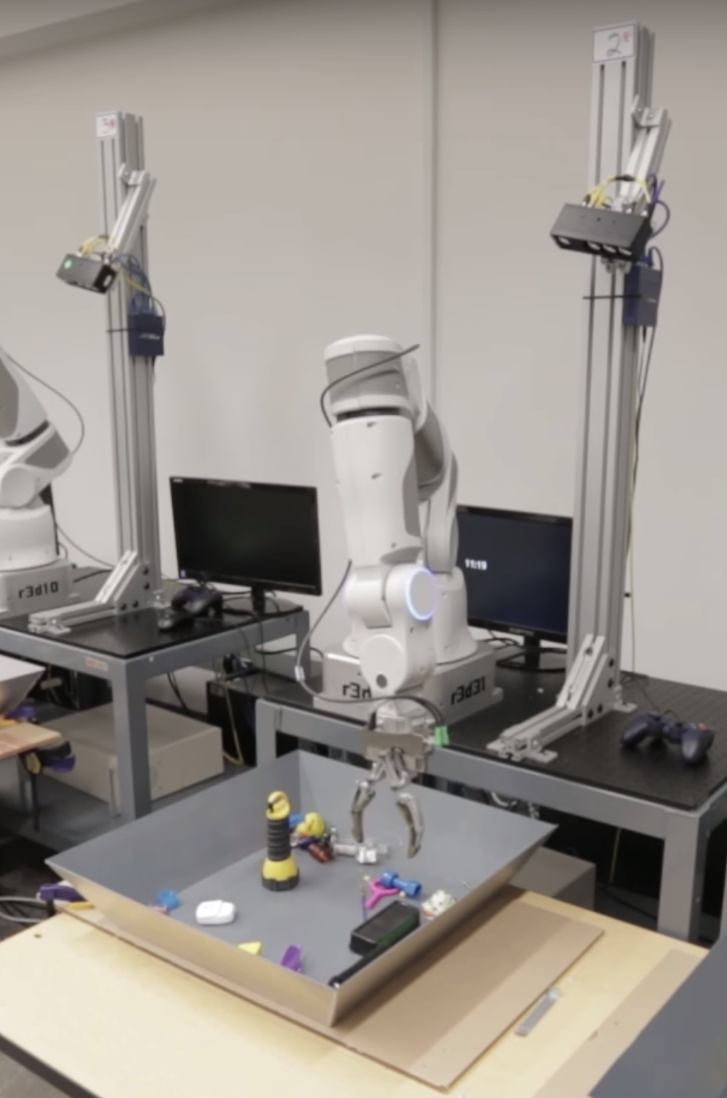
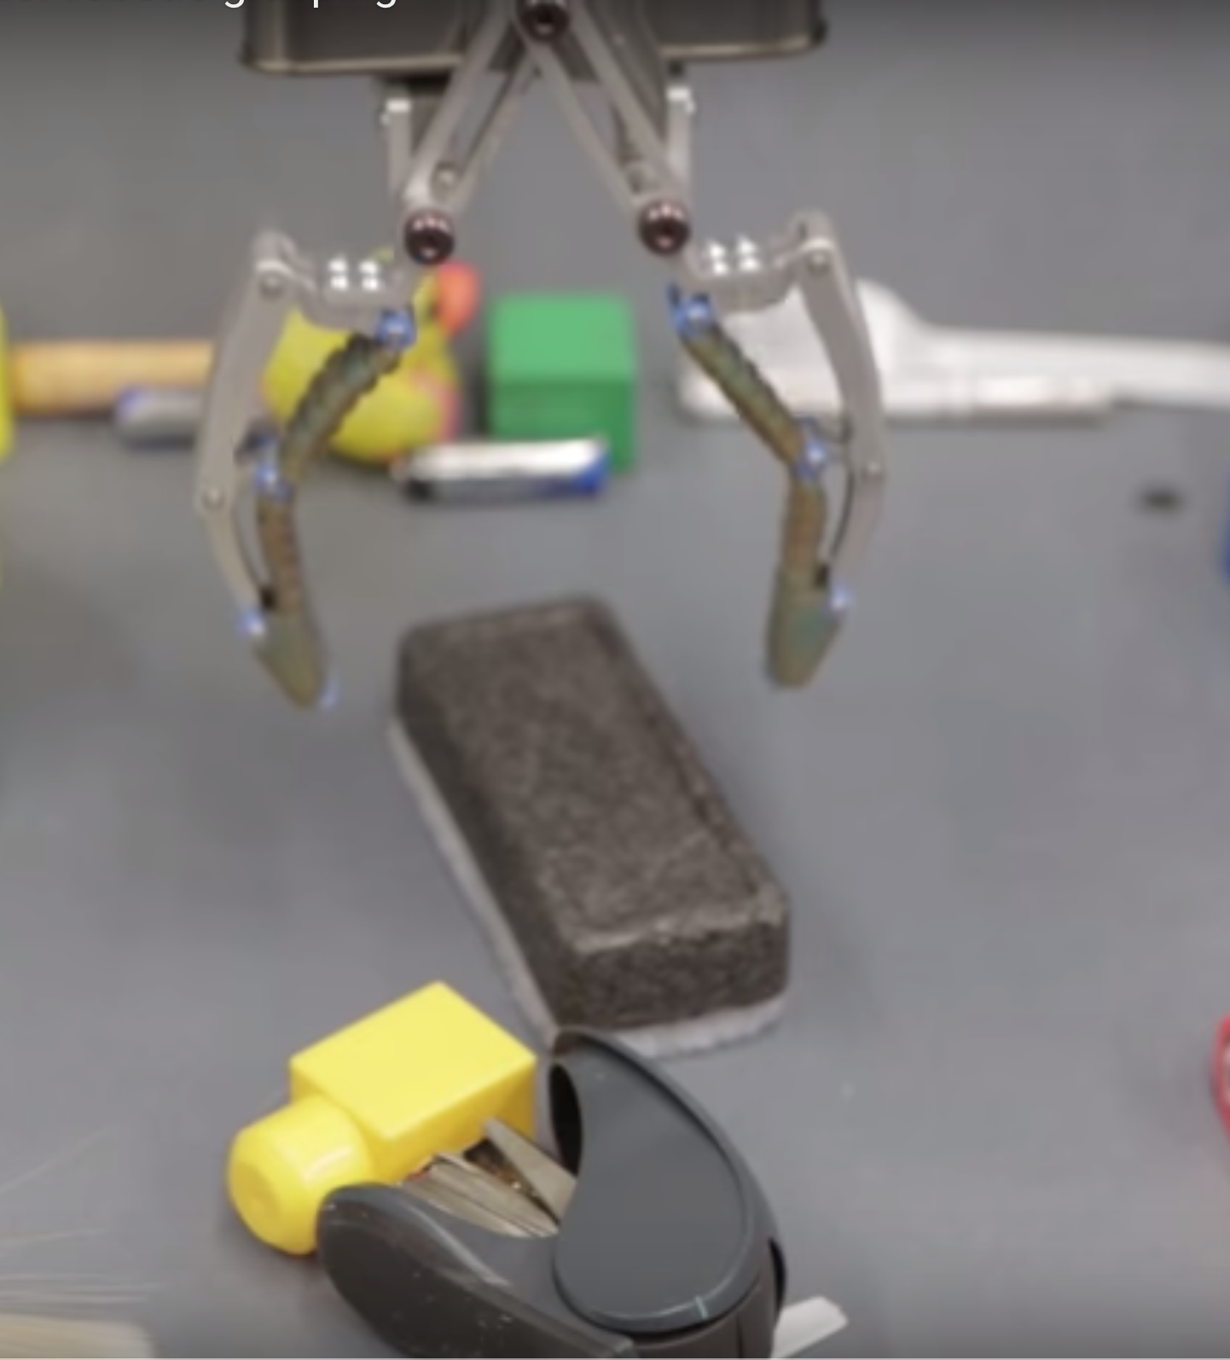
Grasp Sample Setup: Current Time Step, t
I_{t}^{i}
Grasp attempt i
Learning Hand-Eye Coordination
Notes:
Maggie
Now I’m going to talk about how team generated data for training the CNN grasp predictor. They did this by attempting grasps using physical robots.
As you can see here, an uncalibrated camera is mounted near the robot to produce a monocular image, denoted as I_t.
At each time step, the current image (I_t) and pose (p_t) are recorded, and then the robot chooses a direction along which to move the gripper.

Slide 70
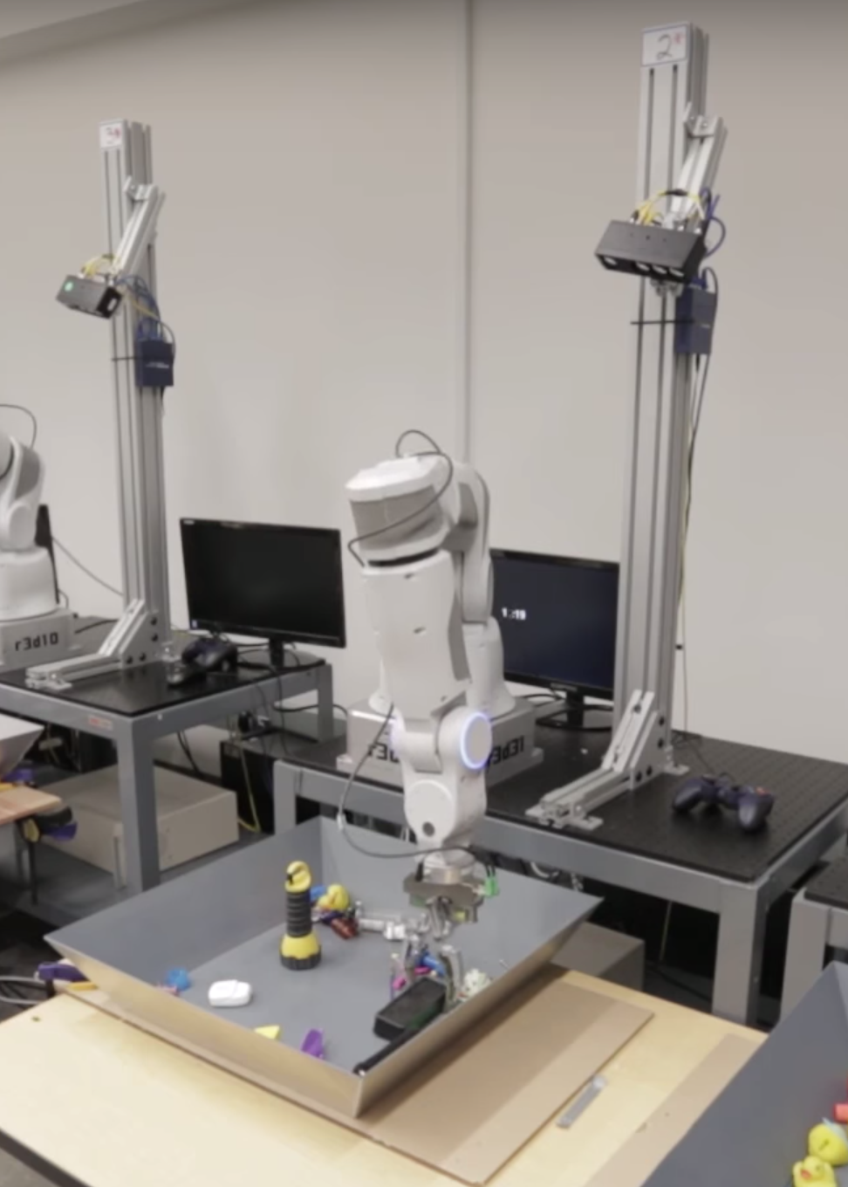
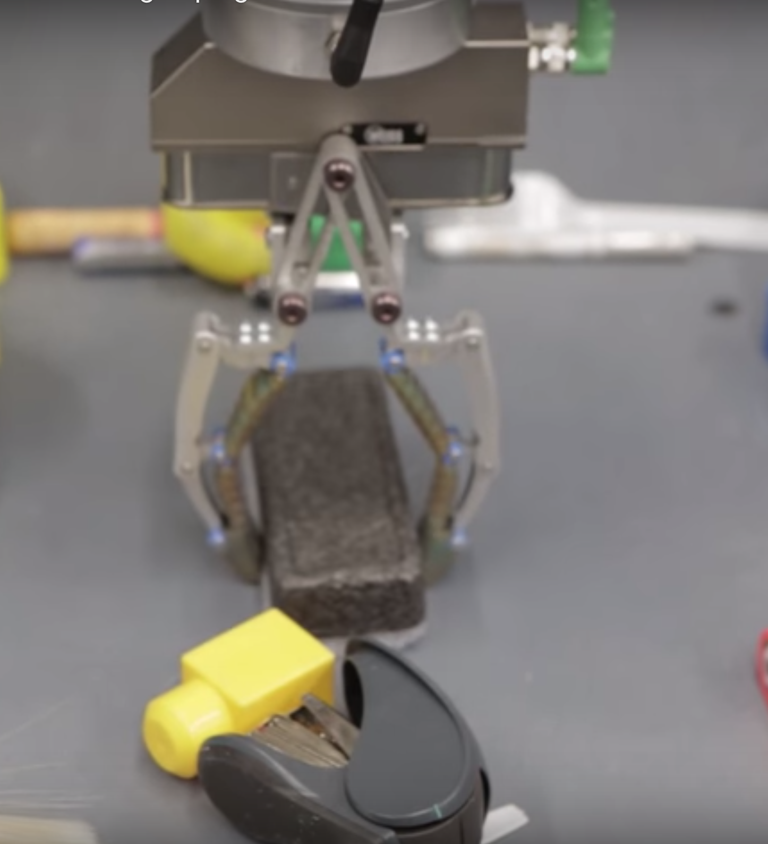
Grasp Sample Setup: Final Time Step, T
Current pose, p_{t}^{i}
Final pose, p_{T}^{i}
Task-space motion, v_{t}^{i}
Label, l_{t}^{i}
(I_{t}^{i}, p_{T}^{i} - p_{t}^{i}, l_{t}^{i})
Learning Hand-Eye Coordination
Notes:
Maggie
At the final time step, T, the robot closes the gripper and evaluates the success of the grasp, producing a label l_i.
We record the final pose, and as a result, we get v_t, the task-space motion.
Each grasp attempt results in T training samples, given by (I_t^i, p_T^i - p, I_t).

Slide 71
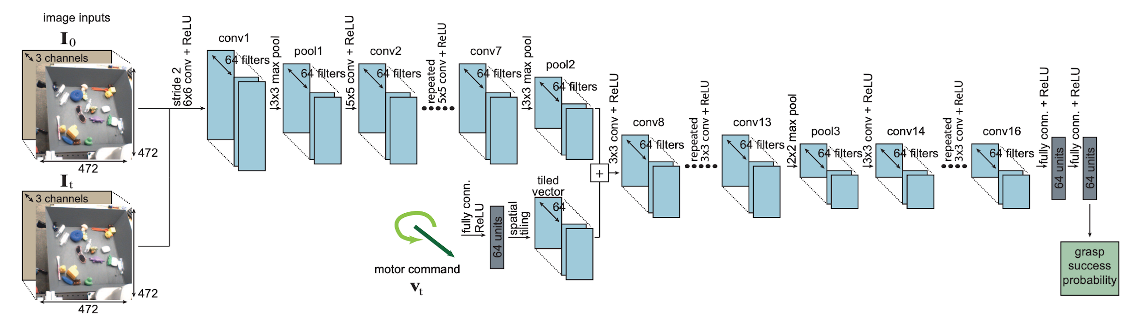
Neural Network Architecture for g(I_{t}, v_{t})
Network predicts the probability of success of a given motor command,
independent of the exact camera pose
Learning Hand-Eye Coordination
Notes:
Maggie
After Google got this dataset, they fed it into this CNN that predicts the probability of success of a given motor command.
This was difficult because the network had to parse the current camera image, locate the gripper, and determine whether moving the gripper according to the motor command would put it in a position where closing the fingers will pick up an object.

Slide 72
Neural Network Architecture for g(I_{t}, v_{t})
Input I_{t} and I₀
5 convolutional layers with batch normalization, followed by max pooling
Learning Hand-Eye Coordination
Notes:
Maggie
The network first takes in the current image and an unoccluded image of the setup. It goes through five convolutional layers each with batch normalization, followed by max pooling.
-----
6x6 convolution with stride 2
3x3 max-pooling
six 5x5 convolutions
3x3 max-pooling layer

Slide 73
Neural Network Architecture for g(I_{t}, v_{t})
The motor command v_{t} = p_{T} - p_{t} is sent to 64 FC units
and then concatenated with visual activations
Learning Hand-Eye Coordination
Notes:
Maggie
The motor command, which is represented by a 3D translation vector and a sine-cosine encoding of the change in orientation of the gripper about the vertical axis, is then sent to a fully connected layer, which is then concatenated with the visual activations.

Slide 74
Neural Network Architecture for g(I_{t}, v_{t})
Is it just standard CNN architecture to add in the vector after the image has been processed for a few steps, or was there some underlying reason why the authors chose to do that?
Learning Hand-Eye Coordination
Notes:
Maggie
Someone on HOTCRP asked why the vector was added after the image, and that’s actually pretty common practice in CNNs, especially with different data types.

Slide 75
Neural Network Architecture for g(I_{t}, v_{t})
The combined activations are fed through another 9 CNN layers
Learning Hand-Eye Coordination
Notes:
Maggie
The combined activations are fed through another 9 CNN layers.

Slide 76
Neural Network Architecture for g(I_{t}, v_{t})
The output features are fed into 2 fully connected layers
with sigmoid activation to predict grasp success probability
Learning Hand-Eye Coordination
Notes:
Maggie
Lastly, the output features are fed into 2 FC layers with sigmoid activation to predict grasp success probability.
So I covered the CNN architecture used in this paper -- does anyone have any questions?

Slide 77
Main Contributions
Physical system: 7 DOF robot arm, 2 finger gripper, and an uncalibrated monocular camera
Novel CNN architecture that predicts grasping success
Continuous visual servoing function controls the robot
Large-scale data collection framework for robotic grasps
Learning Hand-Eye Coordination
Notes:
Maggie
Now, I’m going to talk about how they created a continuous visual servoing function to control the robot.

Slide 78
Servoing Mechanism f(I_{t}) - Algorithm
Given current image I_{t} and network g.
Infer v_{t}* using g and CEM
Evaluate p = g(I_{t}, 0) / g(I_{t}, v_{t}*)
if p > 0.9 then
Output 0, close gripper.
else if p <= 0.5, then
Modify v_{t}* to raise gripper height and execute v_{t}*
else
Execute v_{t}*
end if
Learning Hand-Eye Coordination
Notes:
Maggie
Here is the servoing function. It’s quite simple. Instead of sampling points randomly to get the best motor command, v_t, they use a gradient-free optimization method.

Slide 79
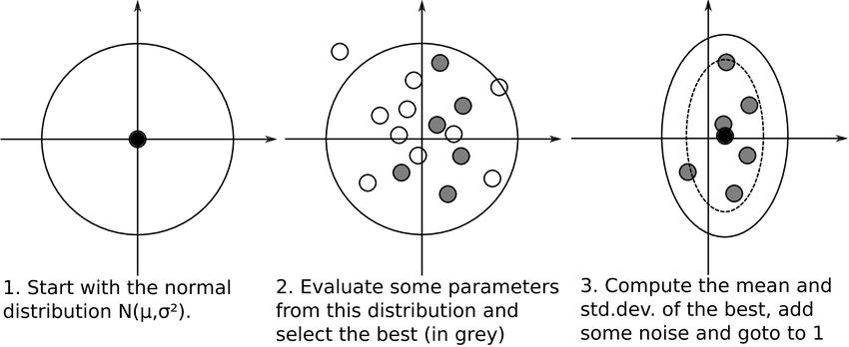
Cross-Entropy Method for Optimization on v_{t}
Samples a batch of N values at each iteration
Fits a Gaussian distribution to M < N of these samples from this Gaussian
Used N = 64 and M = 6; performed three iterations of CEM to determine the best available command v_{t}* to evaluate f(I_{t}), the servoing mechanism
Learning Hand-Eye Coordination
Notes:
Maggie
The intuition on how CEM works is that a batch of N values gets sampled at each iteration. M of these N points gets used to fit a Gaussian distribution.
This repeats until
Monte Carlo method for importance sampling and optimization
--
Simplest approach would be to randomly sample candidate vt, then choose the one with the highest score
Better method, CEM - gradient-free optimization

Slide 80
Adding Heuristics for Raising and Lowering the Gripper
Given current image I_{t} and network g.
Infer v_{t}* using g and CEM
Evaluate p = g(I_{t}, 0) / g(I_{t}, v_{t}*)
if p > 0.9 then
Output 0, close gripper.
else if p ≤ 0.5, then
Modify v_{t}* to raise gripper height and execute v_{t}*
else
Execute v_{t}*
end if
Learning Hand-Eye Coordination
Notes:
Maggie
Evaluate p = g(I_t, 0)/ g(I_t, v_t*), where the 0 corresponds to no motion
If this probability is greater than 0.9, then there is very little benefit to moving again, so we just close the gripper.
If the probability is less than 0.5, then modify the best policy to raise the gripper height and then execute this policy.
Otherwise, we execute our best policy.
The limitation to this is that it’s pretty ad-hoc.
Any questions?

Slide 81

Main Contributions
Physical system: 7 DOF robot arm, 2 finger gripper, and an uncalibrated monocular camera
Novel CNN architecture that predicts grasping success
Continuous visual servoing function controls the robot
Large-scale data collection framework for robotic grasps
Parallels with RL
Learning Hand-Eye Coordination
Notes:
Maggie
Relationship between training the grasp prediction network and reinforcement learning.

Slide 82
Parallels with Reinforcement Learning
The g network is similar to a Q-function in RL, but not quite the same
If T = 2, then g really is a Q function (action-value function)
Policy is the servoing mechanism f(I_{t})
Reward function is 1 when the grasp succeeds and 0 otherwise
When T < 2, then g is approximately a Q function, if the path taken from start to end position isn’t important and only the final position matters
This approximation isn’t 100% correct (can bump into other objects along the way) but it’s close enough for the training to work
Learning Hand-Eye Coordination
Notes:
Maggie
Each grasp attempt consists of T time steps
At the start of training, T=2; by the end, T=10
The robot always attempts to pick up the object after the last time step
It can also try to grasp earlier if it detects convergence
One attempt generates T training samples (I_{t}, p_{T} - p_{t}, L)
I_{t} is the camera image, p_{T} is the final position, p_{t} is the current position, L success label
Observe that the motor input v_{t} = p_{T} - p_{t} is the distance to the eventual final position

Slide 83
Main Contributions
Physical system: 7 DOF robot arm, 2 finger gripper, and an uncalibrated monocular camera
Novel CNN architecture that predicts grasping success
Continuous visual servoing function controls the robot
Large-scale data collection framework for robotic grasps
Learning Hand-Eye Coordination
Notes:
Maggie
Main contributions of this work are:
Method for learning continuous visual servoing for robotic grasping from monocular images
Novel CNN architecture for learning to predict the outcome of a grasp attempt
Large-scale data collection framework for robotic grasps.

Slide 84
Data Collection
All data was collected by robots in the real world. No simulators!
The authors used 6-14 robot arms running in parallel over ~2 months and made a total of about 800,000 grasping attempts
The first 400,000 attempts were made with random control and T = 2
Success rate of 10-30%
After the first batch was in, they trained the CNN and used f(I_{t}) for control
Re-trained the network 4 times, gradually increasing T from 2 to 10
Grasp success was evaluated without human annotation
If the gripper was more than 1 cm apart after it closed, it was a success
Took a picture, opened the grippers, and took another picture. If the image changed, they inferred that they dropped a previously grasped object
Learning Hand-Eye Coordination
Notes:
Maggie

Slide 85
Experimental Results
The network was trained on a diverse set of household and office objects
These had varying size, shape, hardness, and texture
The robot was tested on novel objects (unseen in training) with broadly similar attributes
The most important test was success rate in moving objects from one bin to another (grasping without replacement)
The authors never attempted to train the system to grasp any specific object
The robot achieved strong performance, with 80% success on this task
Baselines: human engineered system 65%, open loop control 57%, random 31%
Performance increased substantially with extra training data
Failure rate on grasping 30/120 objects was 17.5% after full training, 25.0% after training on half the data
Learning Hand-Eye Coordination
Notes:
Maggie

Slide 86
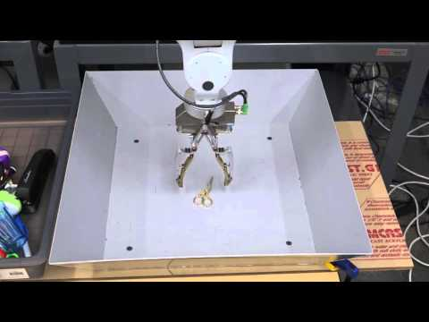
Video
Learning Hand-Eye Coordination
Notes:
Maggie

Slide 87
Novelty of These Results
These results appeared in 2016
First time continuous visual servoing with uncalibrated monocular cameras was used successfully for grasping
Developed a novel CNN architecture that performed well on the task of predicting grasping success from a single camera image
Gathered and published a data set of unprecedented size: 800,000 grasping attempts on a physical robot
Typical real world data set sizes were e.g. 3D scans of 10,000 objects
Other large data sets were only developed on simulators
The authors achieved state of the art performance on the end task of gripping a diverse range of objects in a bin
Learning Hand-Eye Coordination
Notes:
Maggie

Slide 88
Testing Transfer Between Robots
Evaluating whether grasping data collected by one type of robot could be used to improve the grasping proficiency of a different robot
900,000 additional grasp attempts using a different robotic manipulator with a substantially larger variety of objects
Learning Hand-Eye Coordination
Notes:
Maggie

Slide 89
Hardware Setup of Transfer Testing
Learning Hand-Eye Coordination
Notes:
Maggie

Slide 90
Learning Dexterous In-Hand Manipulation
Notes:
MSE

Slide 91
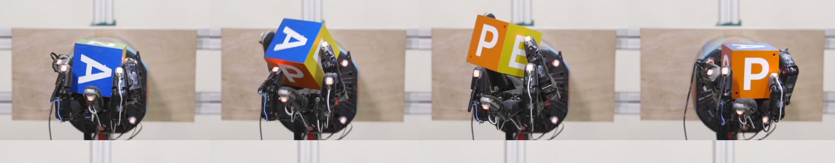
Overview
Authors used RL to train a humanoid hand robot to manipulate a block
Manipulation Task: reorient a block using ground truth from a mocap system or vision only
Training was carried out in a simulated environment
Fidelity of the simulation was only moderate
To overcome the reality gap, authors used domain randomization technique
Training one configuration took about 50 hours, equivalent to ~100 years experience!
Policies learned on simulator were run on a real shadow hand robot
While performance in real life wasn’t as strong as in the simulator, it was still state of the art
Learning Dexterous In-Hand Manipulation
Notes:
MSE

Slide 92
Overview
Authors used RL to train a humanoid hand robot to manipulate a block
Manipulation Task: reorient a block using ground truth from a mocap system or vision only
Training was carried out in a simulated environment
Fidelity of the simulation was only moderate
To overcome the reality gap, authors used domain randomization technique
Training one configuration took about 50 hours, equivalent to ~100 years experience!
Policies learned on simulator were run on a real shadow hand robot
While performance in real life wasn’t as strong as in the simulator, it was still state of the art
Learning Dexterous In-Hand Manipulation
Notes:
MSE

Slide 93
Overview
Authors used RL to train a humanoid hand robot to manipulate a block
Manipulation Task: reorient a block using ground truth from a mocap system or vision only
Training was carried out in a simulated environment
Fidelity of the simulation was only moderate
To overcome the reality gap, authors used domain randomization technique
Training one configuration took about 50 hours, equivalent to ~100 years experience!
Policies learned on simulator were run on a real shadow hand robot
While performance in real life wasn’t as strong as in the simulator, it was still state of the art
Learning Dexterous In-Hand Manipulation
Notes:
MSE

Slide 94
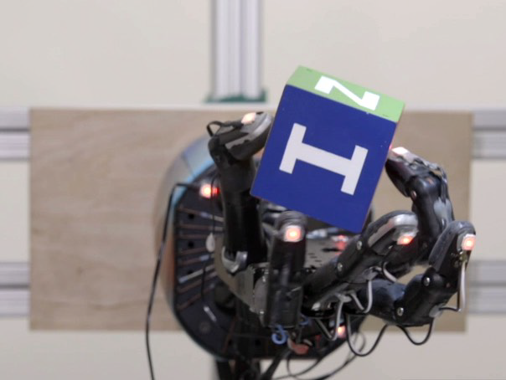
Task Overview
Task: rotate a cubic block to the desired orientation without dropping it
State data: hand and object positions
“Ground Truth” from 16 PhaseSpace trackers (use LEDs on cube and fingertips)
Also estimated from cameras via separate vision model
Learning Dexterous In-Hand Manipulation
Notes:
MSE

Slide 95
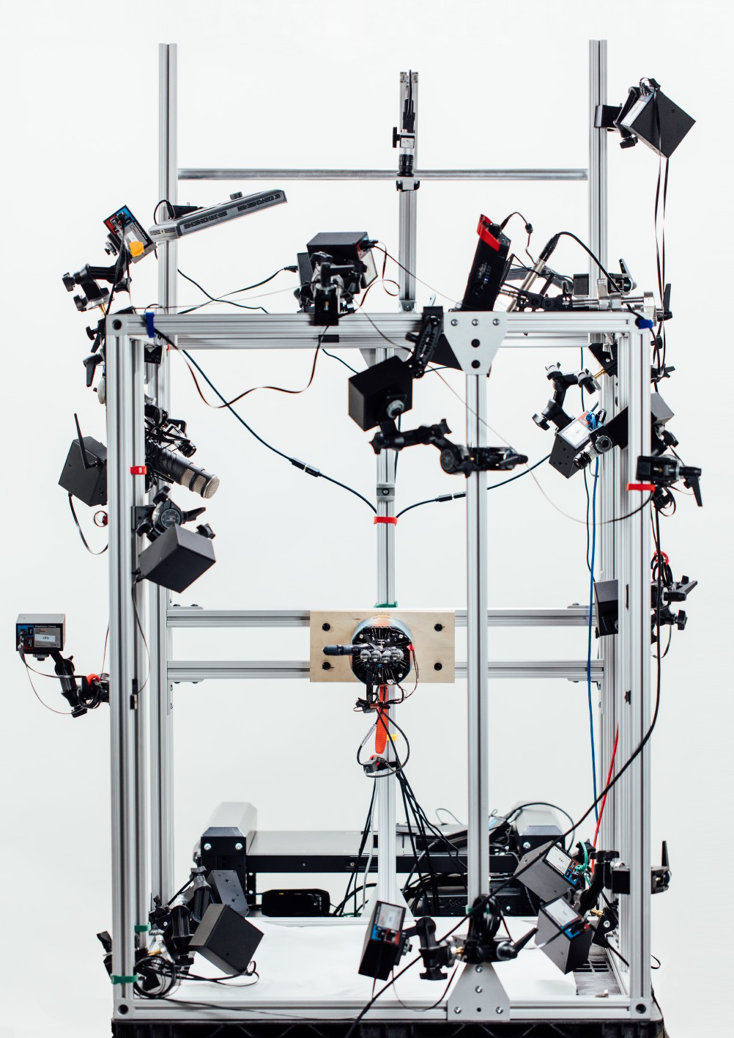
Hardware Overview
Shadow Dexterous Hand robot
Most advanced humanoid hand robot on the market, released 2005
24 degrees of freedom; 20 controls with tendon pairs, DC motors
Hand includes tactile sensors, but these were NOT used!
Cost is not public, discussion thread ~$100k in 2005
Motion capture system: 16 PhaseSpace trackers
LED tags attached to 5 fingertips and block corners
3 cameras used for alternate vision based control
Training hardware: insane computational resources!
6144 CPU cores; est. cost ~$720k
8 NVIDIA V100 GPU; est. cost $90k
Real World Environment: the “cage” houses 1 robot hand, 16 PhaseSpace tracking cameras, and 3 Basler RGB cameras.
Learning Dexterous In-Hand Manipulation
Notes:
MSE

Slide 96
Hardware Overview
Shadow Dexterous Hand robot
Most advanced humanoid hand robot on the market, released 2005
24 degrees of freedom; 20 controls with tendon pairs, DC motors
Hand includes tactile sensors, but these were NOT used!
Cost is not public, discussion thread ~$100k in 2005
Motion capture system: 16 PhaseSpace trackers
LED tags attached to 5 fingertips and block corners
3 cameras used for alternate vision based control
Training hardware: insane computational resources!
6144 CPU cores; est. cost ~$720k
8 NVIDIA V100 GPU; est. cost $90k
Real World Environment: the “cage” houses 1 robot hand, 16 PhaseSpace tracking cameras, and 3 Basler RGB cameras.
Learning Dexterous In-Hand Manipulation
Notes:
MSE

Slide 97
Hardware Overview
Shadow Dexterous Hand robot
Most advanced humanoid hand robot on the market, released 2005
24 degrees of freedom; 20 controls with tendon pairs, DC motors
Hand includes tactile sensors, but these were NOT used!
Cost is not public, discussion thread ~$100k in 2005
Motion capture system: 16 PhaseSpace trackers
LED tags attached to 5 fingertips and block corners
3 cameras used for alternate vision based control
Training hardware: insane computational resources!
6144 CPU cores; est. cost ~$720k
8 NVIDIA V100 GPU; est. cost $90k
Real World Environment: the “cage” houses 1 robot hand, 16 PhaseSpace tracking cameras, and 3 Basler RGB cameras.
Learning Dexterous In-Hand Manipulation
Notes:
MSE

Slide 98
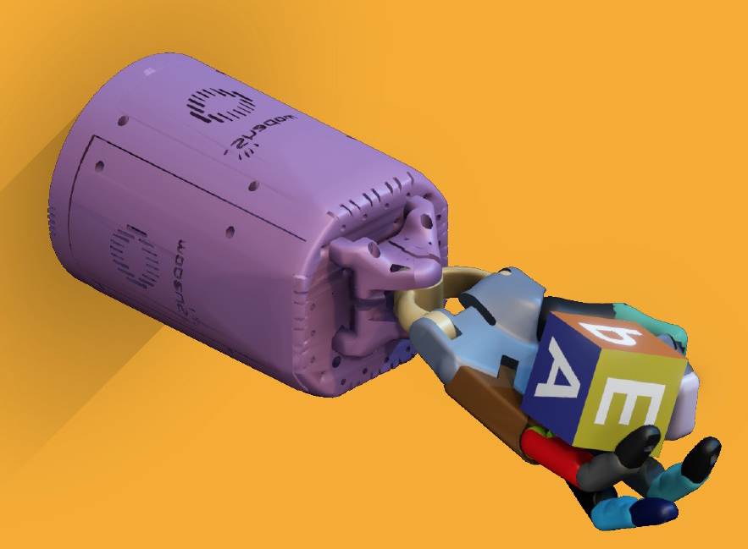
Simulation Overview
Simulation uses model of S.D.H. built in OpenAI Gym
Physics engine provided by MuJoCo
Tendons are ignored; simplified as a single torque
Rigid body simulator; doesn’t handle deformable or semi-rigid finger tips, which are critical for modeling contact points
Scene rendering with Unity video game engine
Rendering of a simulated environment.
Learning Dexterous In-Hand Manipulation
Notes:
MSE

Slide 99
Simulation Overview
Simulation uses model of S.D.H. built in OpenAI Gym
Physics engine provided by MuJoCo
Tendons are ignored; simplified as a single torque
Rigid body simulator; doesn’t handle deformable or semi-rigid finger tips, which are critical for modeling contact points
Scene rendering with Unity video game engine
Rendering of a simulated environment.
Learning Dexterous In-Hand Manipulation
Notes:
MSE

Slide 100
Simulation Overview
Simulation uses model of S.D.H. built in OpenAI Gym
Physics engine provided by MuJoCo
Tendons are ignored; simplified as a single torque
Rigid body simulator; doesn’t handle deformable or semi-rigid finger tips, which are critical for modeling contact points
Scene rendering with Unity video game engine
Rendering of a simulated environment.
Learning Dexterous In-Hand Manipulation
Notes:
MSE

Slide 101
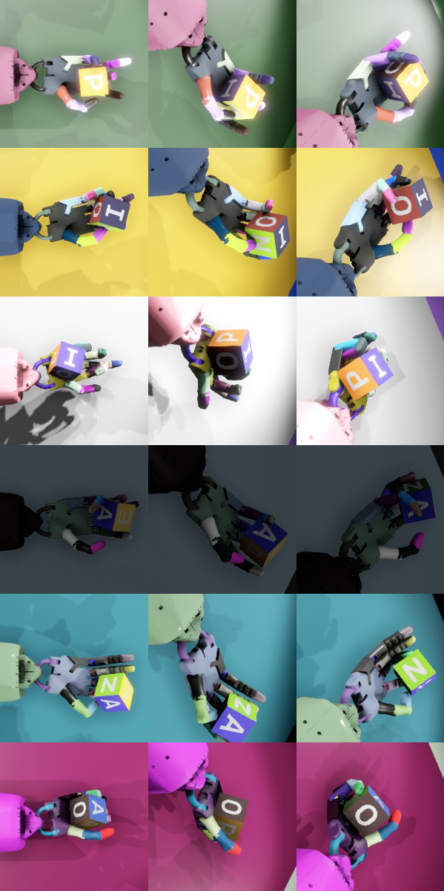
Domain Randomization and Transferable Simulations
One of the biggest challenges is overcoming the “reality gap”
Vary simulation attributes to learn a robust policy that generalizes well and recovers from small errors
Physics parameters
Dimensions, object / robot masses, friction coefficients, joint damping, actuator force gains, joint limits, gravity vector
Unmodeled effects
Small random perturbing forces; actuation delays; joint whiplash
Visual appearance
Color, background color, luminosity, texture are all randomized
All of these randomizations help to limit overfitting
Learning Dexterous In-Hand Manipulation
Notes:
MSE

Slide 102
Domain Randomization and Transferable Simulations
One of the biggest challenges is overcoming the “reality gap”
Vary simulation attributes to learn a robust policy that generalizes well and recovers from small errors
Physics parameters
Dimensions, object / robot masses, friction coefficients, joint damping, actuator force gains, joint limits, gravity vector
Unmodeled effects
Small random perturbing forces; actuation delays; joint whiplash
Visual appearance
Color, background color, luminosity, texture are all randomized
All of these randomizations help to limit overfitting
Learning Dexterous In-Hand Manipulation
Notes:
MSE

Slide 103
Domain Randomization and Transferable Simulations
One of the biggest challenges is overcoming the “reality gap”
Vary simulation attributes to learn a robust policy that generalizes well and recovers from small errors
Physics parameters
Dimensions, object / robot masses, friction coefficients, joint damping, actuator force gains, joint limits, gravity vector
Unmodeled effects
Small random perturbing forces; actuation delays; joint whiplash
Visual appearance
Color, background color, luminosity, texture are all randomized
All of these randomizations help to limit overfitting
Learning Dexterous In-Hand Manipulation
Notes:
MSE

Slide 104
Domain Randomization and Transferable Simulations
One of the biggest challenges is overcoming the “reality gap”
Vary simulation attributes to learn a robust policy that generalizes well and recovers from small errors
Physics parameters
Dimensions, object / robot masses, friction coefficients, joint damping, actuator force gains, joint limits, gravity vector
Unmodeled effects
Small random perturbing forces; actuation delays; joint whiplash
Visual appearance
Color, background color, luminosity, texture are all randomized
All of these randomizations help to limit overfitting
Learning Dexterous In-Hand Manipulation
Notes:
MSE

Slide 105
Domain Randomization and Transferable Simulations
One of the biggest challenges is overcoming the “reality gap”
Vary simulation attributes to learn a robust policy that generalizes well and recovers from small errors
Physics parameters
Dimensions, object / robot masses, friction coefficients, joint damping, actuator force gains, joint limits, gravity vector
Unmodeled effects
Small random perturbing forces; actuation delays; joint whiplash
Visual appearance
Color, background color, luminosity, texture are all randomized
All of these randomizations help to limit overfitting
Learning Dexterous In-Hand Manipulation
Notes:
MSE

Slide 106
Reinforcement Learning 101
Mapping key concepts back to RL 101
Environment: hand and block as simulated by MuJoCo
State: 85 DOF with hand position, block position and orientation; and velocities
Action: Torque applied to each joint
Reward: Proximity to goal orientation; reaching goal; not dropping block
Policy 𝝅, Value function V are both neural networks (Deep RL)
Actor Critic: simultaneously train 𝝅 and V
Alternative to older value iteration and policy iteration approaches
PPO: Proximal Policy Optimization - popular on-policy method using deep nets
Why not DQN or DDPG?
DQN only learns the policy; less powerful here because it helps to also learn state function
DDPG is off-policy; this problem naturally lends itself to on-policy (learn by trying task in simulator)
Learning Dexterous In-Hand Manipulation
Notes:
MSE
why do they use PPO
actor-critic

Slide 107
Reinforcement Learning 101
Mapping key concepts back to RL 101
Environment: hand and block as simulated by MuJoCo
State: 85 DOF with hand position, block position and orientation; and velocities
Action: Torque applied to each joint
Reward: Proximity to goal orientation; reaching goal; not dropping block
Policy 𝝅, Value function V are both neural networks (Deep RL)
Actor Critic: simultaneously train 𝝅 and V
Alternative to older value iteration and policy iteration approaches
PPO: Proximal Policy Optimization - popular on-policy method using deep nets
Why not DQN or DDPG?
DQN only learns the policy; less powerful here because it helps to also learn state function
DDPG is off-policy; this problem naturally lends itself to on-policy (learn by trying task in simulator)
Learning Dexterous In-Hand Manipulation
Notes:
MSE
why do they use PPO
actor-critic

Slide 108
Reinforcement Learning 101
Mapping key concepts back to RL 101
Environment: hand and block as simulated by MuJoCo
State: 85 DOF with hand position, block position and orientation; and velocities
Action: Torque applied to each joint
Reward: Proximity to goal orientation; reaching goal; not dropping block
Policy 𝝅, Value function V are both neural networks (Deep RL)
Actor Critic: simultaneously train 𝝅 and V
Alternative to older value iteration and policy iteration approaches
PPO: Proximal Policy Optimization - popular on-policy method using deep nets
Why not DQN or DDPG?
DQN only learns the policy; less powerful here because it helps to also learn state function
DDPG is off-policy; this problem naturally lends itself to on-policy (learn by trying task in simulator)
Learning Dexterous In-Hand Manipulation
Notes:
MSE
why do they use PPO
actor-critic

Slide 109
Reinforcement Learning 101
Mapping key concepts back to RL 101
Environment: hand and block as simulated by MuJoCo
State: 85 DOF with hand position, block position and orientation; and velocities
Action: Torque applied to each joint
Reward: Proximity to goal orientation; reaching goal; not dropping block
Policy 𝝅, Value function V are both neural networks (Deep RL)
Actor Critic: simultaneously train 𝝅 and V
Alternative to older value iteration and policy iteration approaches
PPO: Proximal Policy Optimization - popular on-policy method using deep nets
Why not DQN or DDPG?
DQN only learns the policy; less powerful here because it helps to also learn state function
DDPG is off-policy; this problem naturally lends itself to on-policy (learn by trying task in simulator)
Learning Dexterous In-Hand Manipulation
Notes:
MSE
why do they use PPO
actor-critic

Slide 110
Reinforcement Learning 101
Mapping key concepts back to RL 101
Environment: hand and block as simulated by MuJoCo
State: 85 DOF with hand position, block position and orientation; and velocities
Action: Torque applied to each joint
Reward: Proximity to goal orientation; reaching goal; not dropping block
Policy 𝝅, Value function V are both neural networks (Deep RL)
Actor Critic: simultaneously train 𝝅 and V
Alternative to older value iteration and policy iteration approaches
PPO: Proximal Policy Optimization - popular on-policy method using deep nets
Why not DQN or DDPG?
DQN only learns the policy; less powerful here because it helps to also learn state function
DDPG is off-policy; this problem naturally lends itself to on-policy (learn by trying task in simulator)
Learning Dexterous In-Hand Manipulation
Notes:
MSE
why do they use PPO
actor-critic

Slide 111
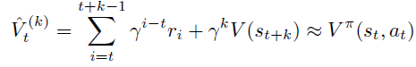
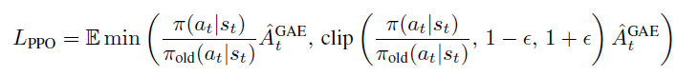
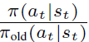
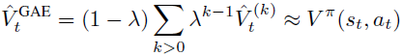

RL Techniques Used: GAE and PPO
Generalized Advantage Estimator (GAE)
Training is more stable for A^{GAE} than for the value function V.
Proximal Policy Optimization (PPO)
PPO encourages the policy to shift actions with better than average payoffs, but the clipping discourages changes that are too large (“proximal”)
Is the ratio of taking the action between the old and new policies; ϵ is a hyperparameter, often 0.2
Learning Dexterous In-Hand Manipulation
Notes:
MSE

Slide 112

LSTM Overview
Images Credit: CS 109b Lecture Notes, Spring 2019
Learning Dexterous In-Hand Manipulation
Notes:
MSE: Maps a sequence of features X_t to a

Slide 113

LSTM: Detail of One Cell
Images Credit: CS 109b Lecture Notes, Spring 2019
Learning Dexterous In-Hand Manipulation
Notes:
MSE

Slide 114
Learning Control Policies from State
Policy is a recurrent neural network (RNN) with memory (LSTM)
As this network process inputs, it updates its internal state (memory)
Trained using Proximal Policy Optimization (PPO) with policy and value networks
Asymmetric actor-critic method; critic has more inputs than actor
State Variables for Policy & Value Networks
Position of 5 fingertips (15 dim); position of object (3D); relative orientation to goal (4D quaternion); total 22 dimensions
Value net also has orientations for object and target; joint angles; and velocities; total 85 dim
Actions: Discretized Joint Angles (11 Bins)
Rewards: Angular Distance, Bonus for Success, Penalty for Drop
Learning Dexterous In-Hand Manipulation
Notes:
MSE

Slide 115
Learning Control Policies from State
Policy is a recurrent neural network (RNN) with memory (LSTM)
As this network process inputs, it updates its internal state (memory)
Trained using Proximal Policy Optimization (PPO) with policy and value networks
Asymmetric actor-critic method; critic has more inputs than actor
State Variables for Policy & Value Networks
Position of 5 fingertips (15 dim); position of object (3D); relative orientation to goal (4D quaternion); total 22 dimensions
Value net also has orientations for object and target; joint angles; and velocities; total 85 dim
Actions: Discretized Joint Angles (11 Bins)
Rewards: Angular Distance, Bonus for Success, Penalty for Drop
Learning Dexterous In-Hand Manipulation
Notes:
MSE

Slide 116
Learning Control Policies from State
Policy is a recurrent neural network (RNN) with memory (LSTM)
As this network process inputs, it updates its internal state (memory)
Trained using Proximal Policy Optimization (PPO) with policy and value networks
Asymmetric actor-critic method; critic has more inputs than actor
State Variables for Policy & Value Networks
Position of 5 fingertips (15 dim); position of object (3D); relative orientation to goal (4D quaternion); total 22 dimensions
Value net also has orientations for object and target; joint angles; and velocities; total 85 dim
Actions: Discretized Joint Angles (11 Bins)
Rewards: Angular Distance, Bonus for Success, Penalty for Drop
Learning Dexterous In-Hand Manipulation
Notes:
MSE

Slide 117
Learning Control Policies from State
Policy is a recurrent neural network (RNN) with memory (LSTM)
As this network process inputs, it updates its internal state (memory)
Trained using Proximal Policy Optimization (PPO) with policy and value networks
Asymmetric actor-critic method; critic has more inputs than actor
State Variables for Policy & Value Networks
Position of 5 fingertips (15 dim); position of object (3D); relative orientation to goal (4D quaternion); total 22 dimensions
Value net also has orientations for object and target; joint angles; and velocities; total 85 dim
Actions: Discretized Joint Angles (11 Bins)
Rewards: Angular Distance, Bonus for Success, Penalty for Drop
Learning Dexterous In-Hand Manipulation
Notes:
MSE

Slide 118

Estimating State with Vision
The simulator is trained based on position data
The robot can use either “ground truth” position data from the mocap system, or from RGB camera data
They trained an auxiliary network to learn position from cameras
Results weren’t as good as with the mocap, but still respectable
Learning Dexterous In-Hand Manipulation
Notes:
MSE

Slide 119
Estimating State with Vision
The simulator is trained based on position data
The robot can use either “ground truth” position data from the mocap system, or from RGB camera data
They trained an auxiliary network to learn position from cameras
Results weren’t as good as with the mocap, but still respectable
Learning Dexterous In-Hand Manipulation
Notes:
MSE

Slide 120
Estimating State with Vision
The simulator is trained based on position data
The robot can use either “ground truth” position data from the mocap system, or from RGB camera data
They trained an auxiliary network to learn position from cameras
Results weren’t as good as with the mocap, but still respectable
Learning Dexterous In-Hand Manipulation
Notes:
MSE

Slide 121
Estimating State with Vision
The simulator is trained based on position data
The robot can use either “ground truth” position data from the mocap system, or from RGB camera data
They trained an auxiliary network to learn position from cameras
Results weren’t as good as with the mocap, but still respectable
Learning Dexterous In-Hand Manipulation
Notes:
MSE

Slide 122

Experimental Results
The robot learned this task with performance comparable to a person
It also learned grasp types similar to those used by people
Benchmark experiment: 80 attempts, ending after 80 seconds or 1 drop
Stylized Findings
Robot does better in simulation
Significant drop to real hand, but performance still respectable
Modest further drop using camera
Some transfer learning for octagonal prism task
Learning Dexterous In-Hand Manipulation
Notes:
MSE

Slide 123

Video
Learning Dexterous In-Hand Manipulation
Notes:
MSE

Slide 124
Stupid Human Tricks: Block Manipulation
Task 1: Try to manipulate the block to different positions using one hand similar to the way the robot did
Task 2: Try again with your eyes closed after initial glimpse
Conclusion 1: This task isn’t as trivial as picking objects, but it’s not hard
Conclusion 2: By using only vision and not touch, the robot is losing a lot of very useful sensory information. The human way of doing this is much more tactile.
Learning Dexterous In-Hand Manipulation
Notes:
MSE

Slide 125

OpenAI Gym: An Accessible RL Environment
OpenAI gym is a python environment for RL
https://gym.openai.com/docs/, https://github.com/openai/gym
Very user friendly; pip install gym and you are off to the races
Here is a minimal program demonstrating it
import gym
env = gym.make('CartPole-v0')
env.reset()
for _ in range(1000):
env.render()
env.step(env.action_space.sample())
# take a random action
env.close()
Background and Motivation
Notes:
MSE

Slide 126

MuJoCo: A Physics Simulator for Robotics
Multi-Joint dynamics with Contact
Developed at University of Washington Movement Control Laboratory
Now developed commercially by Roboti LLC
http://mujoco.org/,
Physics engine for R&D in robotics, biomechanics, graphics & animation
Background and Motivation
Notes:
MSE

Slide 127

Unity Engine: A Scene Rendering Library
Cross-platform video game and rendering engine
Started in 2005 for Apple Mac OS-X; now supported on > 25 platforms
Initially for video games, now used in film, automotive, engineering
Core capabilities: modeling, animation, rendering, simulation
Scenes include digital “assets” that are rendered
These can be purchased or downloaded free, or created from scratch
Example from Unity website: rendering of a BMW.
Unity can create assets from CAD design files!
Background and Motivation
Notes:
MSE

Slide 128
Green AI and Energy Usage in ML
Green AI is a recent trend
Participants considering energy usage in model training, not just final task performance
Some ML achievements have come at the cost of huge energy usage
OpenAI estimated to have spent $30 million (!) training its agent to play DOTA II
It cost an estimated $2 million / 656,000 kWh / 323 tons CO2 to train a Transformer language model (274,000 GPU hours) using Neural Architecture Search (NAS)
This project was relatively energy efficient
Model trained in 50 hours wall time; 400 GPU hours, 3 million CPU hours
Energy usage ~169 kWh based on 300W GPU power, 130W CPU power for 16 cores
Overall Summary
Notes:
MSE

Slide 129
Green AI and Energy Usage in ML
Green AI is a recent trend
Participants considering energy usage in model training, not just final task performance
Some ML achievements have come at the cost of huge energy usage
OpenAI estimated to have spent $30 million (!) training its agent to play DOTA II
It cost an estimated $2 million / 656,000 kWh / 323 tons CO2 to train a Transformer language model (274,000 GPU hours) using Neural Architecture Search (NAS)
This project was relatively energy efficient
Model trained in 50 hours wall time; 400 GPU hours, 3 million CPU hours
Energy usage ~169 kWh based on 300W GPU power, 130W CPU power for 16 cores
Overall Summary
Notes:
MSE

Slide 130
Green AI and Energy Usage in ML
Green AI is a recent trend
Participants considering energy usage in model training, not just final task performance
Some ML achievements have come at the cost of huge energy usage
OpenAI estimated to have spent $30 million (!) training its agent to play DOTA II
It cost an estimated $2 million / 656,000 kWh / 323 tons CO2 to train a Transformer language model (274,000 GPU hours) using Neural Architecture Search (NAS)
This project was relatively energy efficient
Model trained in 50 hours wall time; 400 GPU hours; 300,000 CPU hours
Energy usage ~2600 kWh based on 300W GPU power, 130W CPU power for 16 cores
Overall Summary
Notes:
MSE

Slide 131
Contributions, Context,
Limitations, and Future Work

Slide 132


Hardware Systems
Mechanical Hands
Simplistic
Antipodal - 2 parameters: Angle, location, then just close
Complicated:
Shadow-Hand
Tendon-based, very painful to re-thread
Similar method in Yale OpenHand
How to make them robust?
Robot arm
Collaborative robots: Way safer and lighter
No longer need cages
IK / path planning can be ignored
Overall Summary
Notes:
Nao - todo video of yale openhand precursor taking hammer whackes
Ben carrying staubli

Slide 133


Novelty of These Results -- Limitations & Future Work
Work Since Then (software)
Domain randomization
FAT
Hierarchical (e.g. dishwasher)
Grasping in cluttered / occluded environments
Future work: dynamic movements?
https://giant.gfycat.com/AcceptablePoorAsiaticlesserfreshwaterclam.webm
“World’s fastest workers”
Dart throwing
Grasping around corners / non anti-podal grasp
Grasping around objects (e.g. shelf)
Overall Summary
Notes:
Nao
Expand this into two slides -- picture of different robot arms

Slide 134

Questions they raise
What role can manipulation play in day-to-day life?
Immobile 6 DoF arm
Extensive sensing required for ShadowHand
How can we accelerate manipulation research?
What previously unachievable areas of robotics can machine learning let us imagine?
Are the limitations just in hardware now?
Overall Summary
Notes:
Nao

Slide 135
Conclusion (both papers) + project ideas
We can learn robust robotic manipulation strategies in end-to-end methods, given ‘enough data”
Robust even to hardware inaccuracies
Robotic grasping: bin pick-and-place almost a solved problem since 2016, due to ease of collecting real-life and simulation data
In-hand manipulation still open field
(Project ideas TBD)
Overall Summary
Notes:
Nao

Slide 136

Not Stupid Human Trick: Winter Wind Etude
As a counterpoint to the trivial and easy human manipulation tasks…
Here is a human taking on a “manipulation task” at the apex of difficulty
This is a video of Evgeny Kissin playing a notoriously difficult piano piece: Chopin’s Etude Opus 25, Number 11, nicknamed “Winter Wind”
Whether or not you are a fan of classical piano, consider this for a moment merely as a motion planning problem
The speed and precision required are astounding!
Background and Motivation
Notes:
MSE

Slide 137
Stupid Human Tricks I: Picking and Packing
In-Class demonstration with volunteers
Task 1: Pick and pack objects from one bin to another with two hands
Task 2: Use just one hand
Task 3: Use one hand with only two fingers (thumb and index finger)
Task 4: Use one hand, all fingers, but blindfolded
Conclusion: Humans are way better at picking and packing than this robot!
Background and Motivation
Notes:
Nao

